Slide 1
Flyers Reading and Writing Part 2
Class 4
Thursday April 23

Slide 2
Read the questions and think about possible answers:
Where do you live?
Can the answer be:
Yes, I do.
NO!
Near the library.
YES!
Explanation:
Wh- questions cannot be answered by Yes/No.

Slide 3
Let’s go to the cinema.
Do you like Maths?
Can the answer be:
Can the answer be:
No, I’m not!
NO!
Yes, I do.
YES!
That’s a good idea.
YES!
I have two.
NO!
Have you got a sister?
Did you see Peter yesterday?.
Can the answer be:
Can the answer be:
No, I won’t.
NO!
No, I didn’t.
YES!
NO!
YES!
No, I’m not.
Yes, I have.

Slide 4
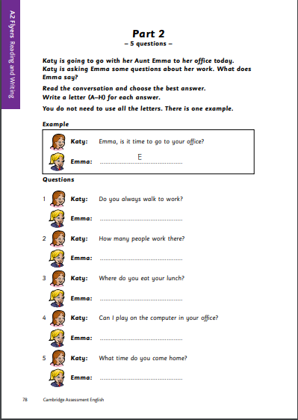
Warming up
Go to the following link and download pages 78 and 79: https://www.cambridgeenglish.org/Images/young-learners-sample-papers-2018-vol1.pdf
Read the dialogue on page 78 (don’t look for answers yet).
Think about possible answers or responses to each question without reading page 79.
Look at what comes after a gap (blank space for your answer), as well as before it, to decide what the answer may be.

Slide 5
Making Predictions
Predicting answers is a very useful strategy for the test.
This encourages you to think carefully about what kind of answer/response may follow a question/statement and so makes it easier to select the correct answer.

Slide 6
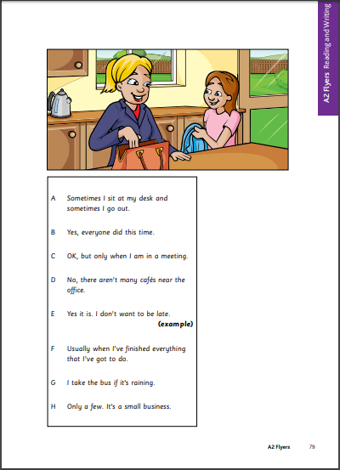
Activity
Take out pages 78 and 79.
Read the instructions carefully.
You will find Emma’s correct responses in page 79.
You must write only the letter in each gap (not the full sentence).
There are 2 extra sentences that aren’t needed at all.
Read the example and complete the worksheet.
Check your answers. It’s a good idea to read the whole dialogue from beginning to end to check.

Slide 7
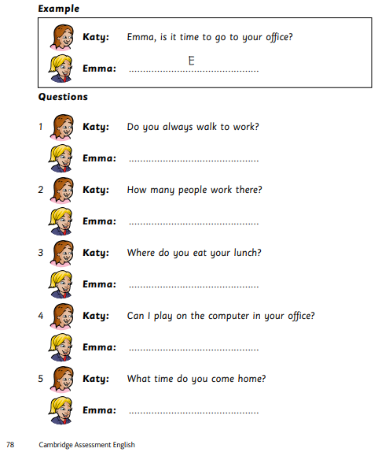
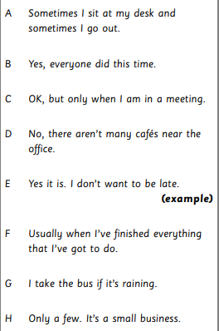
Check your work
G
H
A
C
F

