Slide 1
Flyers Reading and Writing
Part 3

Slide 2
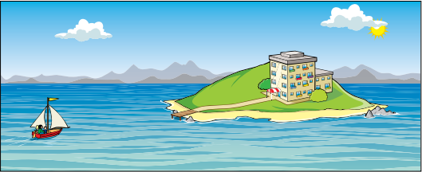
Look at the picture.
Guess what the story is about.

Slide 3
Read the text wthout thinking on the gaps (blanks)
Last weekend, Harry and his parents went to a small hotel on an island in a lake. On Saturday afternoon the hotel cook went by boat to the town to see a friend. But then suddenly a (1) .................................... came, with rain and strong winds, and he couldn’t sail back to the hotel. At six o’clock everyone in the hotel went to the (2) .................................... to have dinner, but it was closed. ‘What’s the matter?’ Harry’s mum asked the waiter. ‘The dinner isn’t (3) ................................... ,’ he said, ‘because there is no-one to cook.’
So Harry’s parents decided to do something. They went into the kitchen where they looked in the (4) .................................... and in the cupboards. They found some flour, tomatoes, cheese and vegetables. Dad made pizzas and Mum (5) .................................... the vegetables into small pieces for a salad. ‘That smells good,’ said the waiter. Harry ate a piece of pizza. ‘And it tastes very good!’ he said. Everyone loved the dinner and thanked Harry’s parents.

Slide 4
What do you think this story is about?
Harry’s family ended up making some pizza in the Hotel’s restaurant because the cook wasn’t there.
It’s important for you to get used to thinking about the meaning of the whole text and not only the words around the spaces.

Slide 5
Words tested in this part of the test:
Verbs: action words
Is it in the present, past or future? Does it end in ___ing?
Adverbs: a word used to modify a verb, an adjective, or another adverb. It describes actions, and it describes other descriptive words. For example, slowly, rapidly, sadly, etc.
Nouns: naming words of things, animals, people o places.
Is it simgular or plural?
Adjective: describing words

Slide 6
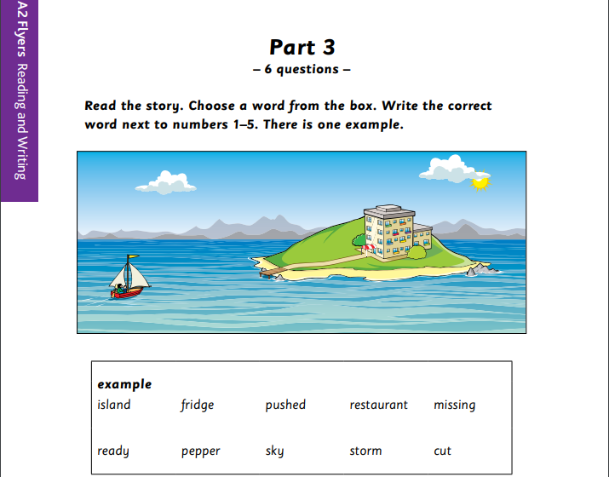
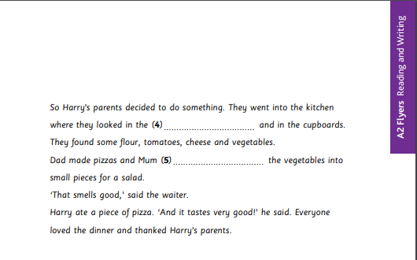
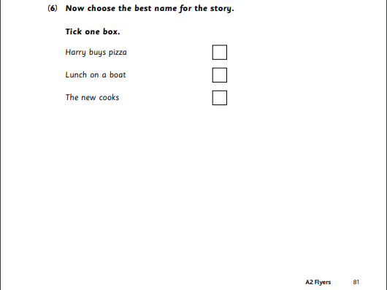
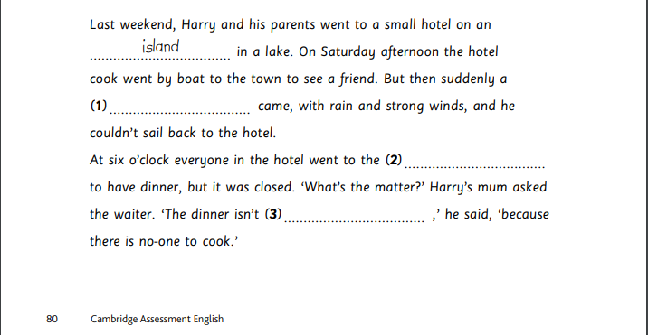
Complete pages 80 and 81
Download them here: https://www.cambridgeenglish.org/Images/young-learners-sample-papers-2018-vol1.pdf

Slide 7
Check your work
fridge
cut
X
storm
restaurant
ready

