Slide 1
Flyers – Reading and Witing Part 5
Friday May 29

Slide 2
School Trip
Think about a school trip you have been on in the past.
Think about what happened there.
Now think about how you felt.
Also think about what happened in the end.

Slide 3
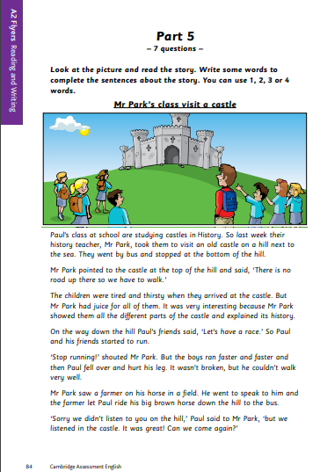
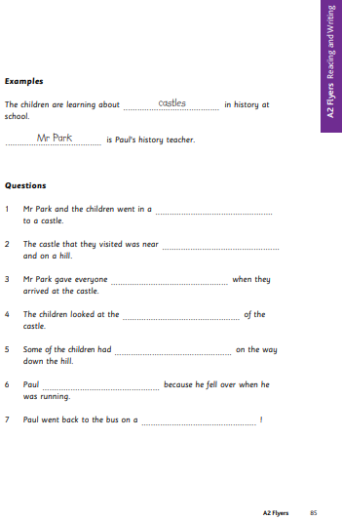
Part 5
Print pages 84 and 85 from this link: https://www.cambridgeenglish.org/images/flyers-sample-papers-2018-vol1.pdf

Slide 4
Look carefully at Page 84. Then answer the following questions:
Where are they?
Who is in the picture?
What are they looking at?
What are they going to do?
Now read the text quietly on your own.
It’s important to practice in reading silently to yourself for the test.

Slide 5
Check that you understand all the vocabulary
Castles
Explain
History
Bottom
Thirsty
Feel over
Hurt
Farmer
Field
If you don’t know this words, make sure to look for their meaning before starting.
In the test, you are going to be able to answer the questions even if you’re not sure of a word

Slide 6
Answer the following questions about the text:
Who is Mr Park?
Who is Paul?
Where did they go on their school trip?
Why did they go there?
How did they get to the castle?
How were the children feeling when they got to the castle?
The teacher
One of the students.
An old castle (on a hill next to the sea).
Because they were studying castles in history class.
They walked.
Tired and thirsty.

Slide 7
What did Paul and his friends want to do after visiting the castle?
What did the teacher say?
What happened to Paul?
Who did the teacher speak to? Why?
How did Paul get down the hill?
Have a race.
“Stop running!”
He fell over and hurt his leg.
A farmer, to borrow his.
He rode the farmer’s horse.

Slide 8
Look carefully at page 85 and answer the questions:
What do you have to write in the spaces in the questions?
How many words can you use in each space?
Can you use words from the text?
Is it OK to write the whole sentence?
After we have read the story, we have to complete the sentences with important information from the story.
1, 2, 3 or 4 words; we must not write more.
Yes; we must be careful to copy words correctly and not make any spelling mistakes.
No, we must ONLY complete the sentence.

Slide 9
Different ways of referring to people or objects
Look at the examples, and underline in different-coloured pens/pencils the part of the text which gives the information you need to fill in the spaces as in the text.
The only difference is that the text is written as Paul’s class/their history teacher, and the sentence as Paul’s history teacher. Also, the text says the children are studying castles, and the example says learning about castles.
Remember that it is important to copy correctly.

Slide 10
Read at the following sentences:
Their history teacher, Mr. Park…
Mr. Park is Paul’s history teacher.
Do these two sentences mean the same thing?
YES, both mean the same thing
For this part of the test, you need to understand how the same meaning can be expressed in different ways.

Slide 11
Activity
Look at the worksheets.
Read the questions and underlin ethe part of the text that show the answer.
Use different colors to underline the different questions.
Once you finish underlining, commplete the answers on page 85

Slide 12
Check your answers
bus
the sea
(some) juice/
a drink (of juice) /
(a) juice (to drink)
(different) parts
a race /
(started to) run
hurt his leg/
couldn’t walk (very well)
(big) (brown) (farmer’s) horse/
farmer’s (big) (brown) horse

