Slide 1
English
Week 2
March 23rd to 27th

Slide 2
Class 1
Tuesday March 24

Slide 3
What do you need?
Metacognition Worksheet.
Pencil or pen.

Slide 4
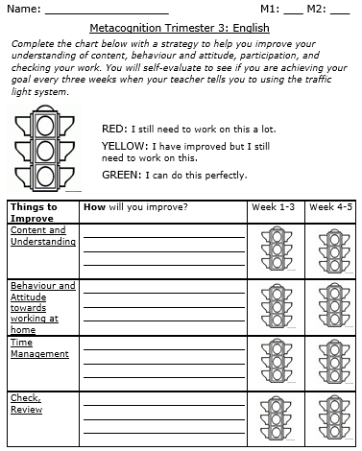
Metacognition Chart
Open the file called Metacognition worksheet. You only have to complete this part:

Slide 5
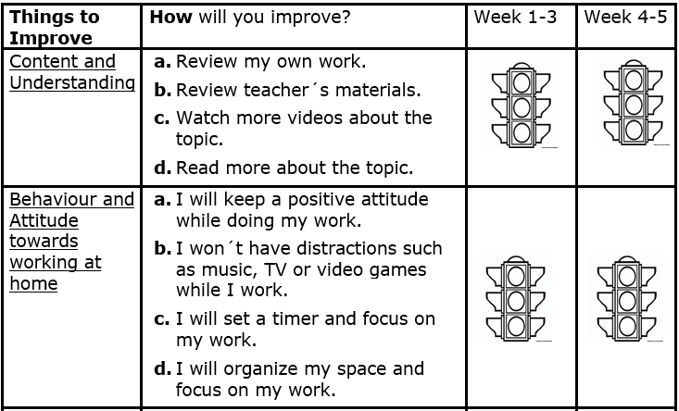
Metacognigion Chart
Choose one of the following options for each box and copy them in your chart. Remember that the option you choose is the one that you will be working on during these weeks. You can write your answers in the file (in the computer) or in a printed version. We’ll be grading this chart once it is completed on week 5.

Slide 6
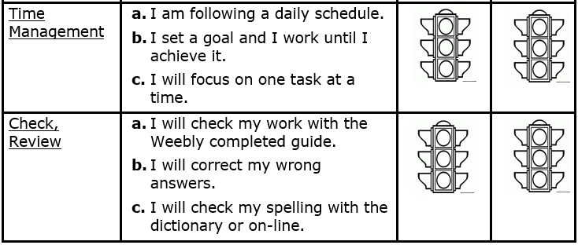
Metacognition Chart

Slide 7
Class 2
Wednesday March 25

Slide 8
What do you need?
English notebook.
Pencil or pen.
Good internet connection.

Slide 9
Past Progressive Practice - Steps
Step 1: Review the past progressive formulas:
Affirmative
Subject + was / were + present+ing (present participle) + complement + .
Negative:
Subject + was / were + not + present+ing (present participle) + complement + .
Interrogative:
Was / Were + subject + present+ing (present participle) + complement + ?
Step 2: watch the following video: https://www.youtube.com/watch?v=t9t4rt7M6wU

Slide 10
Past Progressive Practice - Steps
Step 3: Open your notebook. Write the date and the title in red: Past Progressive Practice.
Step 4: Write alll the past progressive sentences shown in the video.
Step 5: Correct your work. In Weebly you will find an attached file with the answers (English / Term III / Week 2 Worksheets): https://thirdgradecampestre.weebly.com

Slide 11
Class 3
Wednesday March 25

Slide 12
What do you need?
IM2 Past Progressive Worksheet (Entregable).
You need your book: “A Week in the Woods”

Slide 13
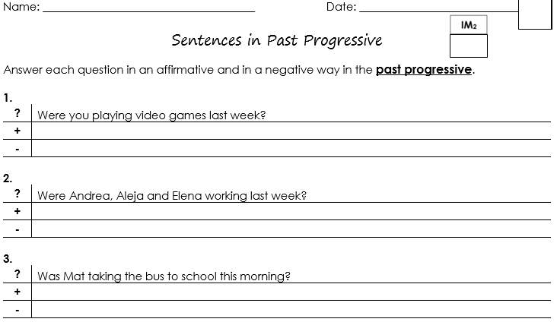
IM2 Past Progressive – “Entregable”
Open the “IM2 Past Progressive” file and complete the following chart. Make sure that you use the past progressive formulas (+, - and ?). Please complete it in a Word document to attach in Phidias. Make sure to write your name and the date. We will be grading IM2.

Slide 14
Read
In this class you will havee to read Chapter six: “Spoiled” (pages 34 – 44).
Think about:
Main Characters
Secondary characters
Main idea
Important Events
Problem

Slide 15
Class 4
Thursday March 26

Slide 16
What do you need?
Book: A Week in the Woods
Worksheet: A Week in the Woods Chapters 6-8. You can download it in Phidias and Weebly.
Pencil, pen or computer.

Slide 17
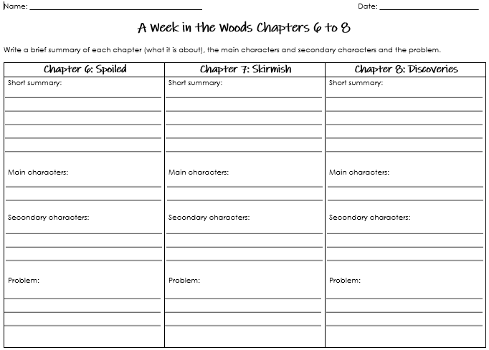
A Week in the Woods Worksheet
Based on chapter 6, you will have to write a short summary, identify the main characters, the secondary characters and the problem of this chapter. You only have to fill in the information for chapter 6. It is important to save this worksheet for the next week. You can find it in Phidias and Weebly: https://thirdgradecampestre.weebly.com
You only have to complete this part

Slide 18
A Week in the Woods Worksheet
Once you finish your work, go to Weebly (https://thirdgradecampestre.weebly.com) and download the file named: “A Week in the Woods Chapters 6-8 Answers”.
Compare and contrast your work with this sample (A Week in the Woods Chapter 6-8 Answers).
Correct your work if you need to.

