Slide 1
English
Week 3
March 30 to April 3

Slide 2
Class 1- Past Progressive and Past Simple
Monday March 30

Slide 3
Step 1: Review
Review the formulas for past simple:
Affirmative
Subject + verb in past simple + complement + .
Negative
Subject + did not (didn’t) + verb in basic (present) + complement + .
Interrogative
Did +Subject + verb in basic (present) + complement + ?

Slide 4
Review the formulas for past progressive:
Affirmative
Subject + was / were + present+ing (present participle) + complement + .
Negative:
Subject + was / were + not + present+ing (present participle) + complement + .
Interrogative:
Was / Were + subject + present+ing (present participle) + complement + ?

Slide 5
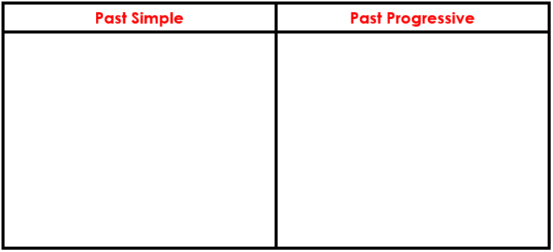
Steps
Step 2: Watch the following video: https://www.youtube.com/watch?v=etvW0FOD_so&t=168s
Step 3: Open your English notebook.
Write the date and the title: Past Simple and Past Progressive.
Step 4: Make a T chart in your notebook like this:

Slide 6
Steps
Step 5: Write 5 sentences you saw on the video for the past simple and 5 for the past progressive.
Step 6: Go to Weebly, download the file called Past Simple and Past Progressive Answers.
Step 7: Correct your work.
Step 8: Go to the following link and take the quiz Past Progressive: https://www.quizalize.com/
Click on Student Login
Class Code: zub2429

Slide 7
Class 2
Tuesday March 31

Slide 8
What do you need?
Book: A Week in the Woods
Worksheet: A Week in the Woods Chapters 6-8. The one you used last week.
Pencil, pen or computer.

Slide 9
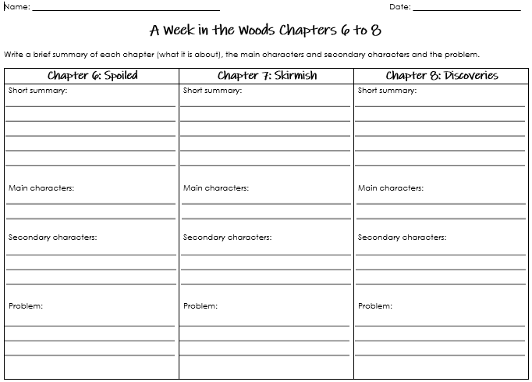
Read Chapter 7 (Skirmish)
Based on chapter 7 (Skirmish), you will have to write a short summary, identify the main characters, the secondary characters and the problem of this chapter. You only have to fill in the information for chapter 7. It is important to save this worksheet for tomorrow’s class.
You only have to complete this part

Slide 10
Review Quiz
We are not grading this quiz, we just want to know if you are understanding the story.
Go to the following link and take the quiz: “A Week in the Woods Chapters 1-7”: https://www.quizalize.com/
Click on Student Login
Class Code: zub2429

Slide 11
Class 3
Wednesday April 1

Slide 12
Reading
Download the summary of chapter 8: Discoveries. You find it attached to the Phidias homework or in Weebly.
Read it carefully.
Complete the worksheet you have been working on.
Compare and contrast your work with the one you find in Weebly with the sample answers.
Correct your work if you need to.

Slide 13
Class 4
Thursday April 2

Slide 14
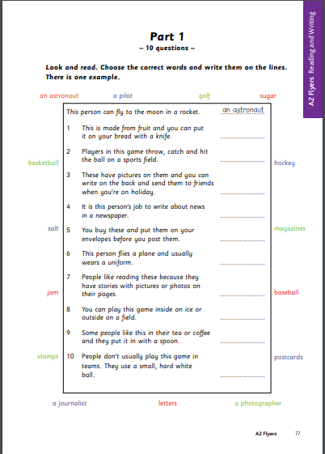
Flyers-Reading and Writing 1
Materials needed:
Power Point: Flyers Class 4 Week 3.
Download page 77 from the following link: https://www.cambridgeenglish.org/Images/young-learners-sample-papers-2018-vol1.pdf
Instructions:
Follow the instructions found on the Power Point Presentation named Flyers Class 4 Week 3.

Slide 15
Class 5
Friday April 3

Slide 16
Raz-Kids
Review the formulas to write sentences in the past progressive.
Log into Raz-Kids.
Go to assignments.
Listen and then read the story called: “The Leprechaun Trap”.
Take the quiz.
Think about a different ending to this story and tell it to one of your parents.

