Slide 1
English
Week 5
April 13th to 17th

Slide 2
Class 1
Tuesday 14

Slide 3
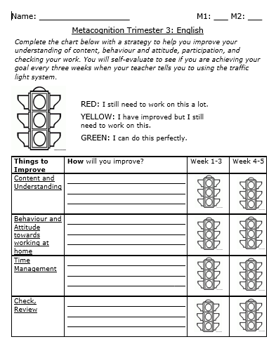
What do you need?
Metacognition Worksheet (you started filling it on week 2).
Good internet connection.
Document: Future Will
English Notebook (Yellow).
Pen or pencil.
Red pen.

Slide 4
Metacognition Chart
Today you will start evaluating your improvements. You will need to color the traffic lights according to your own performance:
Red: Still need to work a lot on this.
Yellow: I have improved, but I still need to work on this.
Green: I can do this perfectly.
You should only color the traffic lights that are in the column called Week 1-3:

Slide 5
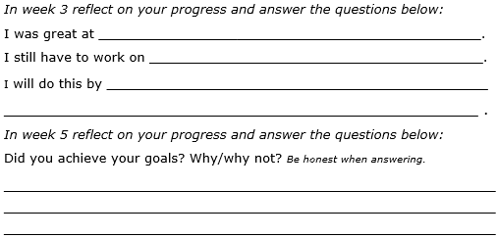
Metacognition chart
After coloring the four traffic lights, please answer the questions for week three:
Keep your worksheet in a safe place. You will need it in a few weeks.

Slide 6
Future Simple – Will and Won’t
Watch the following video: https://www.youtube.com/watch?v=hz4-LkCEHCU .
Download the document called Future Will. You find it in Phidias and on Weebly.
Read and copy those notes in your English Notebook.
Write two examples of affirmative, two examples of negative and two examples of interrogative questions. Make sure to use the formulas.

Slide 7
Future Simple – Will and Won’t
Watch the following video to review: https://www.youtube.com/watch?v=cfNMrfGcZXw
Go to https://www.quizalize.com/
Take the quiz called “Will Won’t”.
Class Code:
3A: wku8689
3B: zub2429
3C: kqb4781

Slide 8
Class 2
Wednesday April 15

Slide 9
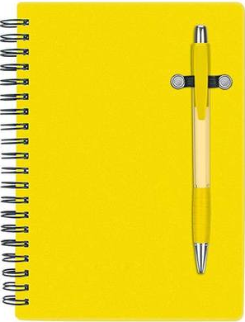
What do you need?
Good internet connection.
Document: Narrative Text Notes.
English Notebook (Yellow).
Pen or pencil.
Red pen or pencil.

Slide 10
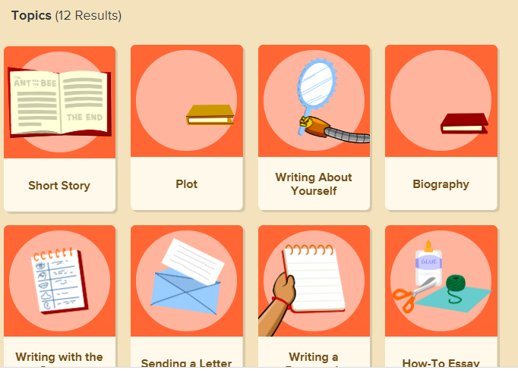
Narrative Text
Go to https://jr.brainpop.com/
User: gimnasiocampestre
Password: campestre
Look for the video titled: Short Story and watch it.

Slide 11
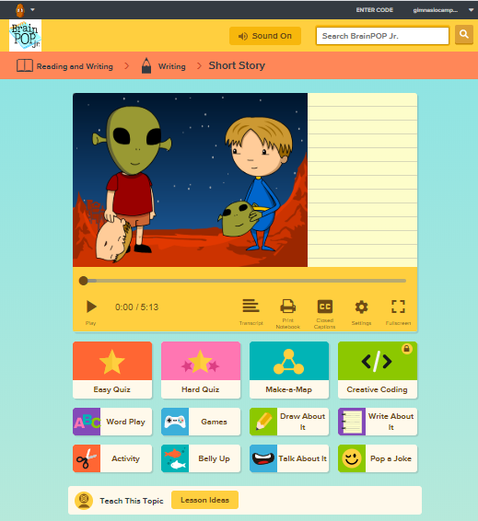
Narrative Text
Download the file called: Narrative Text Notes.
Copy those notes in your English notebook.
Check that your spelling is correct.
Do the easy and hard quiz.

Slide 12
Class 3
Thursday April 15

Slide 13
What do you need?
Book: “A Week in the Woods”.
Good internet connection.

Slide 14
A Week in the Woods
Read Chapter nine: “Testing”.
Identify:
Main idea
Main characters
Seconday characters
Problem
Check if you were right in the next slide.

Slide 15
A Week in the Woods Chapter Nine
Summary:
Mark spends the night alone in the barn. He is proving to himself that he won’t be afraid of the dark. While there, Mark reads a couple of stories and thinks through many events of his life. He realizes that his mother makes him feel like home. His father makes him feel safe and secure. He has also come to the realization that he has been a stuck up brat at school. He makes a pact to himself that he will put more effort into being more kind to the people at school.

Slide 16
A Week in the Woods
Main characters:
Mark
Secondary characters:
Anya, Leon
Problem:
Mark wanted to face his fears of being alone and of the dark by spending the night in the barn, all by himself. There was a storm that made Mark feel scared. He also thought about his parents and his attitude in school, which was a problem too.

Slide 17
A Week in the Woods
Go to: https://www.quizalize.com/
Take the quiz called: A Week in the Woods Chapters 1-9.
Class Code:
3A: wku8689
3B: zub2429
3C: kqb4781
Read each questin really carefully. We will be grading IM1 and CT1.

Slide 18
Class 4
Friday April 17

Slide 19
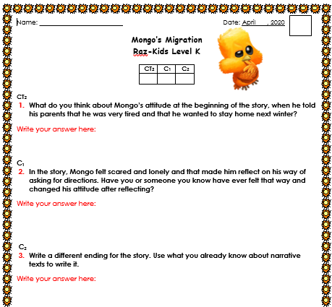
What do you need?
Good internet connection.
File: Mongo’s Migration Evaluation.
Pen or pencil.

Slide 20
Raz-Kids
Login to Raz-Kids
Go to your assignments.
Listen and read the book: “Mongo´s Migration”.

Slide 21
Mongo’s Migration - Entregable
Open the file “Mongo’s Migration Evaluation”.
In that same Word File answer all the questions.
Save it in your computer as a Word Document and make sure you attach it to Phidias at the end of the week (once you have all your “Entregables”).
This time you will be sending it as a separate document from all the rest of “entregables”.

Slide 22
Great Job this week! Have a nice weekend!

