Slide 1
Week 6
April 20 to 24

Slide 2
Class 1:Simple Future – Will WH Questions
Monday April 20

Slide 3
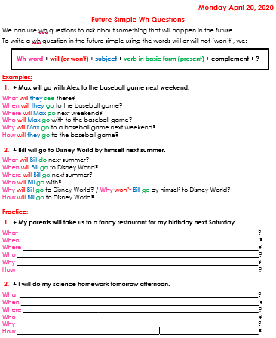
What do you need?
Good internet connection.
English Future Simple Wh Questions
English Notebook (yellow).
Pen or pencil.
Color pens or pencils.

Slide 4
Future Simple – Will Wh Questions
Go to the following link and watch the video: https://www.youtube.com/watch?v=0V3BZm0OflU
Open the file called “English Future Simple Will WH Questions”. You find it in Phidias or Weebly.
Copy it in your English notebook, making sure that you memorize the formula.
Complete the Practice part by following the two examples and using the formula.
Correct your work by opening the document called “Future Simple WH Questions Practice Answers”. You will find it in Weebly/English/Term III https://thirdgradecampestre.weebly.com

Slide 5
Future Simple – Will Wh Questions
Watch the following video to review: https://www.youtube.com/watch?v=PsqEArI0SW4
Go to www.quizalize.com
Class Code:
3A: wku8689
3B: zub2429
3C: kqb4781
Solve the following quiz:
Read each question carefully.
We will be grading IM2.

Slide 6
Class 2: “A Week in the Woods” Chapters 10 and 11
Tuesday April 21

Slide 7
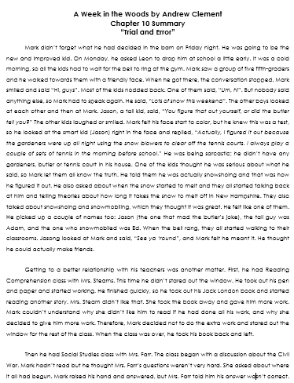
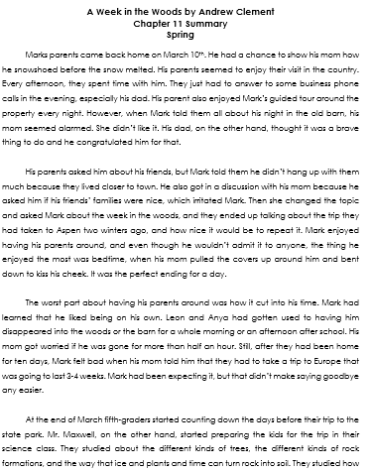
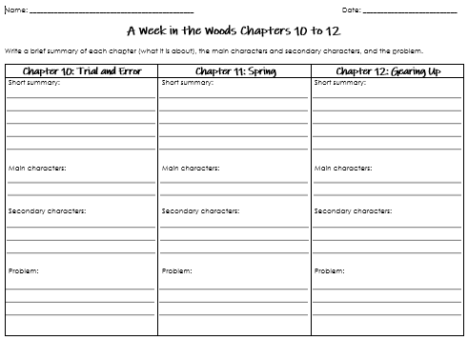
What do you need?
A Week in the Woods Chapter 10 Summary.
A Week in the Woods Chapter 11 Summary.
A Week in the Woods Chapters 10 – 12 Worksheet.
Pen or pencil.

Slide 8
A Week in the Woods Chapters 10 and 11
Review the notes and summaries you have for chapter 1-9.
Read the summary of chapters 10
Fill out the part that corresponds to chapter 10.
Read the summary of chapters 11.
Fill out the part that corresponds to chapter 11.
Check your work: compare and contrast your work with the answers you find in Weebly. Correct your work if you need to. https://thirdgradecampestre.weebly.com Weebly/English/Term III

Slide 9
Class 3: Narrative text, Plot
Wednesday April 22

Slide 10
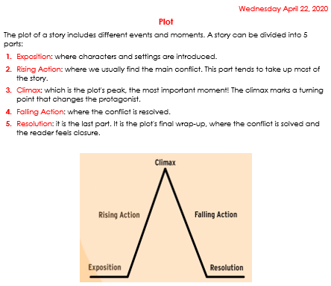
What do you need?
Good internet connection.
Document called “Plot”.
English notebook (yellow).
Pen or pencil.

Slide 11
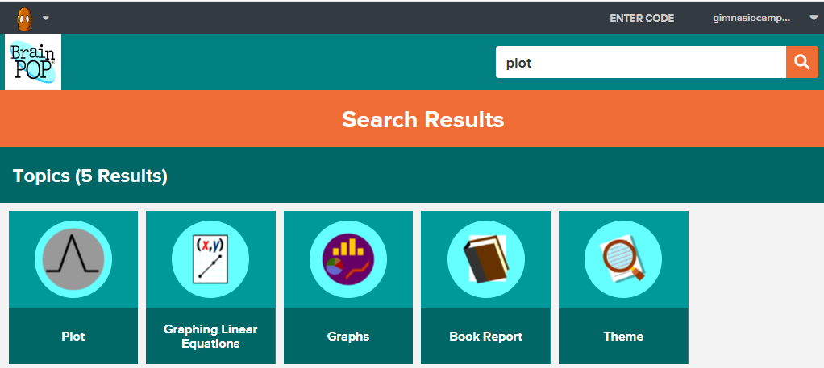
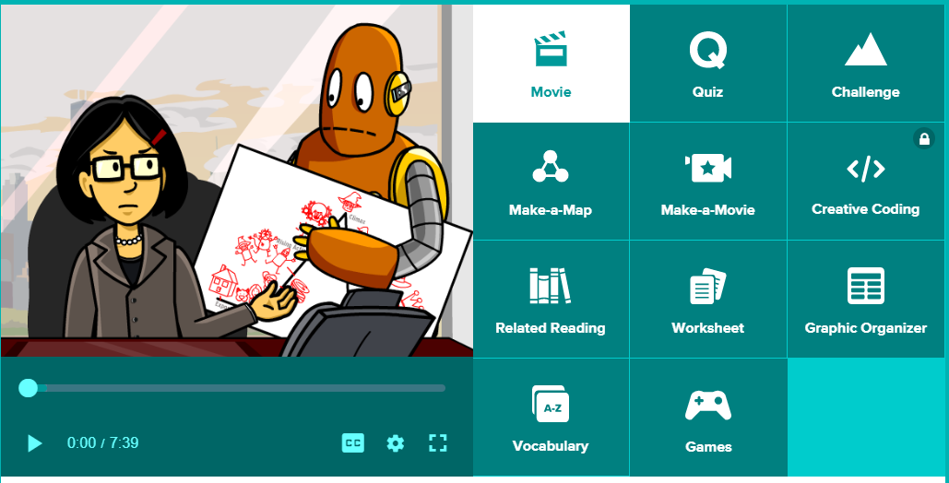
plot
Go to the following link and watch the video called Plot: https://www.brainpop.com/search/?keyword=plot
User: gimnasiocampestre
Password: campestre
Open the document called Plot.
Copy the information found there in your English notebook.
Take the quiz.

Slide 12
Class 4
Thursday April 23

Slide 13
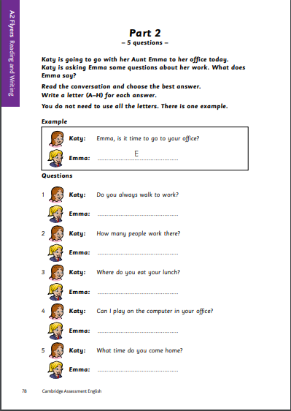
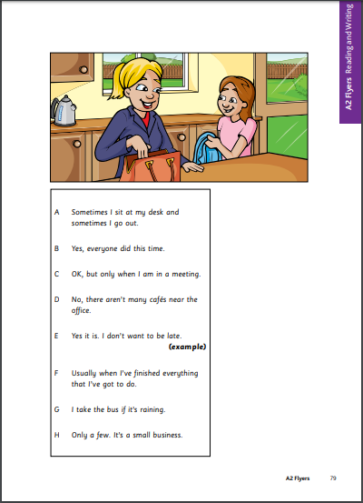
What do you need?
English Flyers Reading and Writing Part2 Power Point Presentation. You can find it in Phidias or Weebly.
Part 2: Pages 78 and 79. Download them in https://www.cambridgeenglish.org/Images/young-learners-sample-papers-2018-vol1.pdf
Pen or pencil.
Follow the instructions you find in the Power Point Presentation.

Slide 14
Class 5
Friday 24

Slide 15
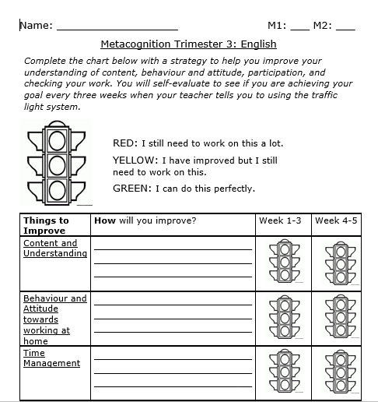
What do you need?
Good internet connection.
Metacognition Worksheet.
Pen or pencil.
Red, yellow and green colours.

Slide 16
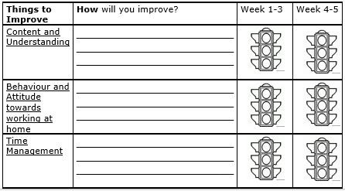
Metacognition Worksheet - Entregable
Take out the metacognition worksheet.
Color the trafic lights under the column called “Week 4-5”. Remember you are assessing your performance during these weeks.
Then answer the question corresponding to week 5.
Now that you have completed it, send it with the PDF File with all of your entregables.
Upload your PDF file to your Phidias homework.

Slide 17
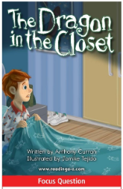
Raz-Kids
Open your Raz-Kids account. Go to your assignments.
Listen and read the story called “The Dragon in the Closet”.
Take the quiz.
Identify the five parts of the plot:
Exposition
Rising Action
Climax
Falling Action
Resolution
Check your answers (next slide)

Slide 18
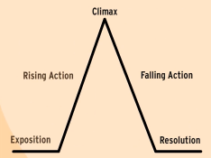
The Dragon in the Closet
Exposition: When the author introduces Simon and tells that he hates bedtime because there’s a dragon that lives in his closet and comes out when the lights are off (pages 3 and 4).
Rising Action: When the closet door creaked and Simon ran to his dad’s room to tell him all about the dragon (pages 5-7).
Climax: When Simon and his dad come back to his room. Simon is very scared as he tells his dad how the dragon that lives in the closet comes out in the dark (pages 8 – 9).
Falling Action: When dad tells Simon he had the same problem with a lion that lived under his bed, but that he ended up being his friend. They ad wonderful adventures together (pages 10 – 14).
Resolution: Dad tells Simon that sometimes the lion still visits and that he’ll tell him to tell the dragon that Simon wants to be his friend. Then Simon goes back to sleep, but this time he is not scared (page 15).

Slide 19
Great Job this week!
Have a nice Weekend!

