Slide 1
Week 7
April 27 to May 1

Slide 2
Class 1
Monday April 27

Slide 3
What do you need?
Good internet connection.
Future Simple Formulas +, -, ?, wh

Slide 4
Review the formulas to write sentences in the Future Simple Will:
Affirmative:
Subject + will + verb in basic (present) + complement + .
Negative:
Subject + will + not + verb in basic (present) + complement + .
Interrogative:
Will + Subject + verb in basic (present) + complement + ?
WH Questions:
Wh-word + will (or won't) + subject + verb in basic form (present) + complement + ?

Slide 5
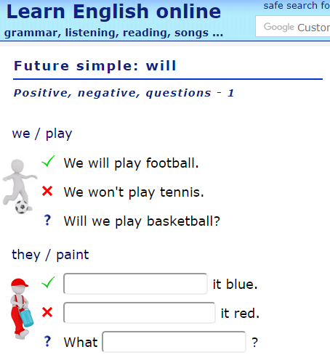
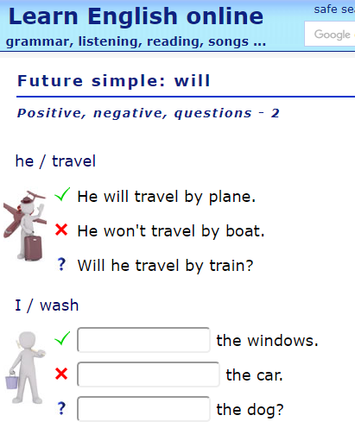
Practice
Watch the following video: https://www.youtube.com/watch?v=Y7byP-mIWPg
Click on the following link and complete the practice: : https://agendaweb.org/exercises/verbs/future/will-positive-negative-questions-write
Then click on this link to finish your practice: https://agendaweb.org/exercises/verbs/future/will-positive-negative-questions-write-2
Check if your answers were correct by clicking on the button at the end of the page.

Slide 6
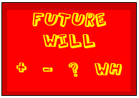
Quiz – IM2
Go to www.quizalize.com
Take the quiz called Future Will + - ? wh.
Class Codes: 3A: wku8689 3B: zub2429 3C: kqb4781

Slide 7
Class 2
Tuesday April 28

Slide 8
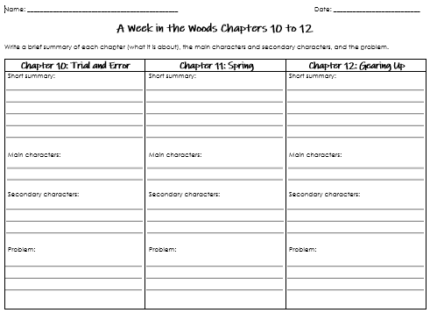
What do you need?
Book: “A Week in the Woods” by Andrew Clements.
“A Week in the Woods Chapters 10 – 12” Worksheet.
Pen or pencil.

Slide 9
Activity
Review what has happen up to chapter 11 in the book.
Read chapter 12: “Gearing Up”.
Complete the worksheet you started last week:
A Week in the Woods Chapters 10 – 12.
Compare and contrast your work with the answers that you find in Weebly.

Slide 10
Class 3
Wednesday April 29

Slide 11
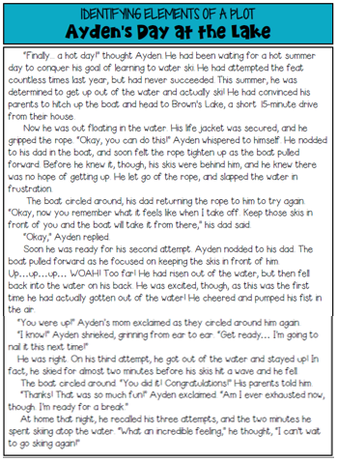
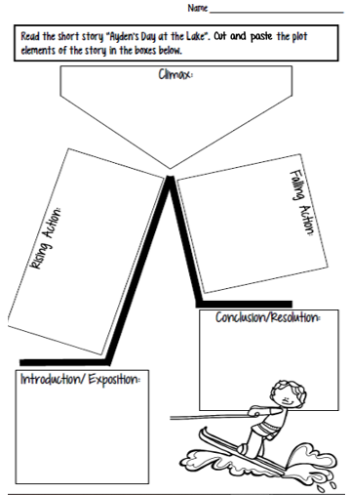
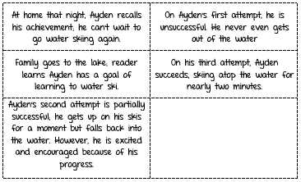
What do you need?
Good internet connection.
Ayden’s Day at the Lake Worksheets.
Pen or pencil.
Scissors.
Glue stick.

Slide 12
Activity
Cut
Review the 5 parts of the Plot:
Exposition (Introduction)
Rising Action
Climax
Falling Action
Resolution (Conclusion)
Read the story called: Ayden’s Day at the Lake
Cut the five cards with the summary of the story.
Paste them in the correct boxes.
Check your work.
Paste

Slide 13
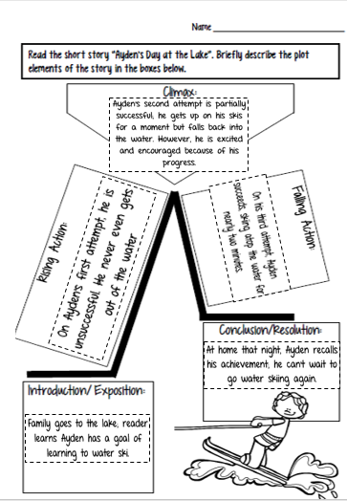
Check your work

Slide 14
Class 4
Thursday April 30

Slide 15
What do you need?
Good internet connection.
English notebook.
Pen or pencil.

Slide 16
Raz - Kids
Review your notes about the future simple.
Log into your account in Raz-Kids
In your assignments you will find the story: “How Zebras Got their Stripes”
Listen to the story
Read the story
Take the quiz
In your notebook copy the sentences you find in the future simple

Slide 17
Check your work.
I will Paint you, and no one will know you are donkeys.
Everyone will be fooled.
I will call you something else.
I will call you zebras.

Slide 18
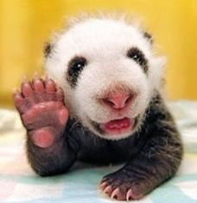
Have a nice long weekend!

