Slide 1
Week 8
May 4 to 8

Slide 2
Class 1
Monday May 4

Slide 3
What do you need?
Good internet connection.
Future will quiz.
Pen or pencil.

Slide 4
Review the Future Simple formulas
Affirmative:
Subject + will + verb in basic (present) + complement + .
Negative:
Subject + will + not + verb in basic (present) + complement + .
Interrogative:
Will + Subject + verb in basic (present) + complement + ?
WH Questions:
Wh-word + will (or won't) + subject + verb in basic form (present) + complement + ?

Slide 5
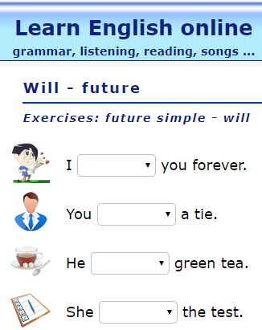
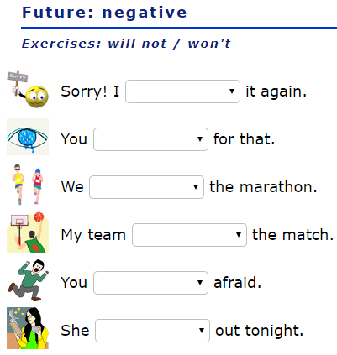
Activity
Go to the following link and complete the activity: https://agendaweb.org/exercises/verbs/future/will-forms
Go to the following link and complee the activity: https://agendaweb.org/exercises/verbs/future/negative-will
Make sure to click on the button check once you finish.
Download the file “Future Will Quiz”. You can complete it in the computer.

Slide 6
Class 2
Tuesday May 5

Slide 7
What do you need?
English A Week in the Wood Chapter 13 and 14 Summary.
A Week in the Woods Chapter 13-15 Worksheet.
Pen or pencil.

Slide 8
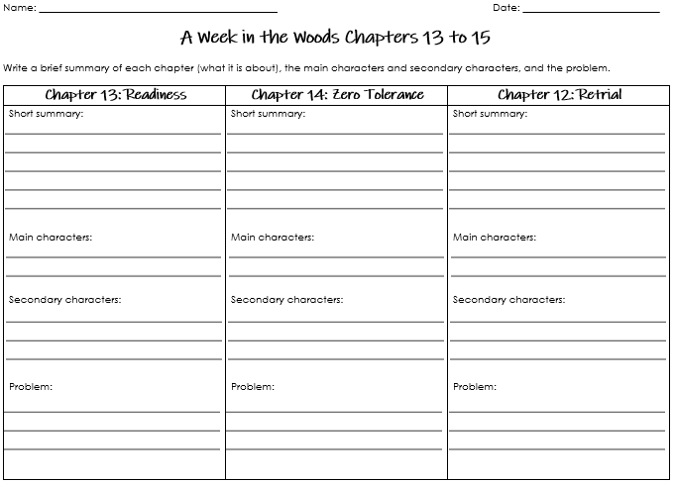
Activity
Read the sumaries for chapter 13 (Readiness) and chapter 14 (Zero Tolerance).
Complete the part for chapter 13 and 14 of the worksheet.

Slide 9
Class 3
Wednesday May 6

Slide 10
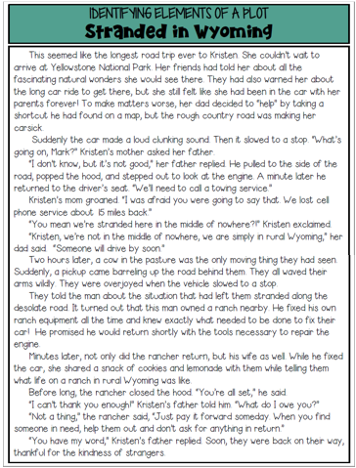
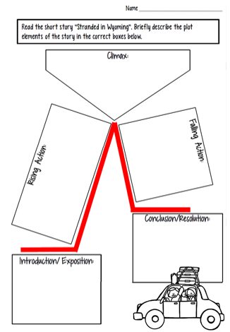
What do you need?
Good internet connection.
Stranded in Wyoming Worksheets.
Pen or pencil.
Scissors.
Glue stick.

Slide 11
Activity
Cut
Paste
Review the 5 parts of the Plot:
Exposition (Introduction)
Rising Action
Climax
Falling Action
Resolution (Conclusion)
Read the story called: Stranded in Wyoming.
Cut the five cards with the summary of the story.
Paste them in the correct boxes.
Read

Slide 12
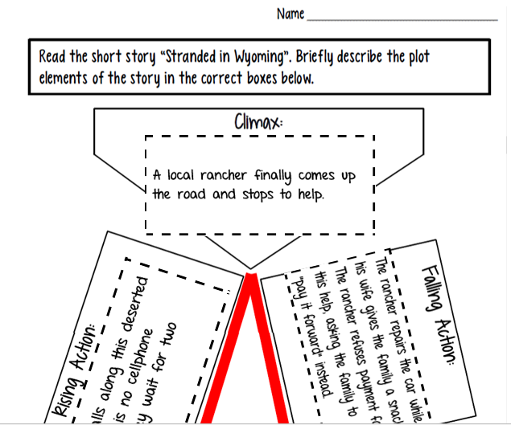
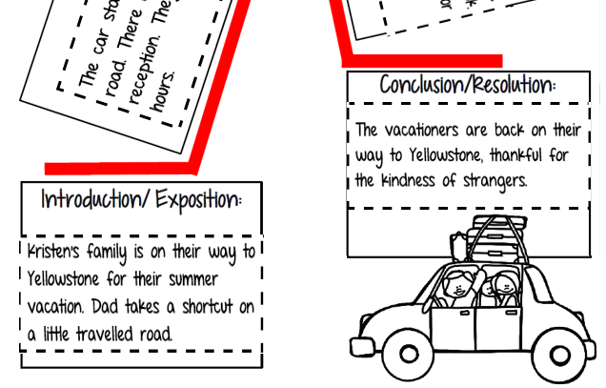
Check your work

Slide 13
Class 4
Thursday May 7

Slide 14
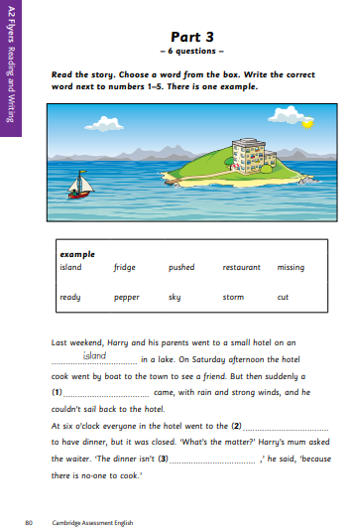
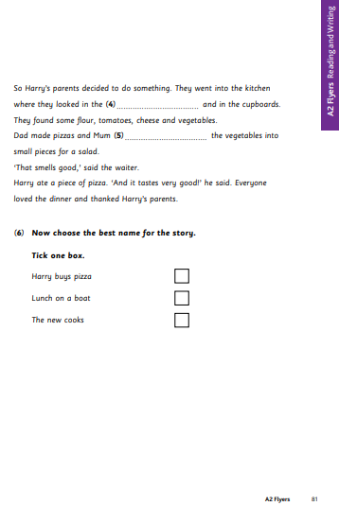
What do you need?
Flyers A2 Reading and Writing Part 3, Pages 80 and 81. Download them here: https://www.cambridgeenglish.org/Images/young-learners-sample-papers-2018-vol1.pdf
English Flyers Reading and Writing Part 3 Power Point Presentation.
Pen or pencil

Slide 15
Activity
Open the English Flyers Reading and Writing Part 3 Power Point Presentation.
Follow the instructions you find there.

Slide 16
Class 5
Friday May 8

Slide 17
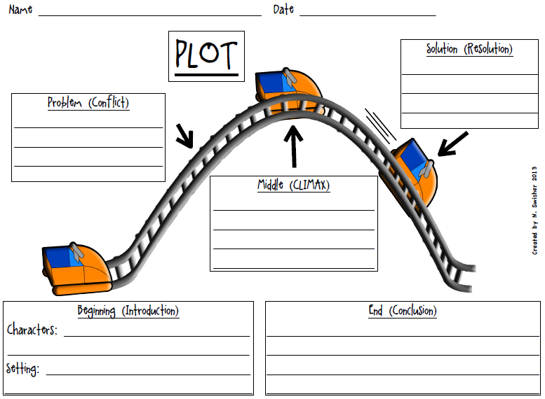
What do you need?
Good internet connection.
English Notebook.
English Project Plot Diagram IM1.
Pen or pencil.

Slide 18
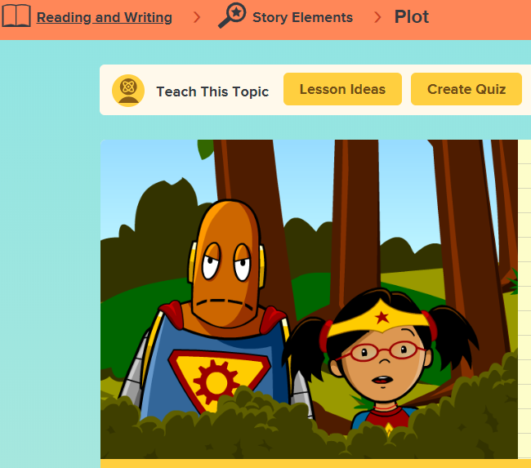
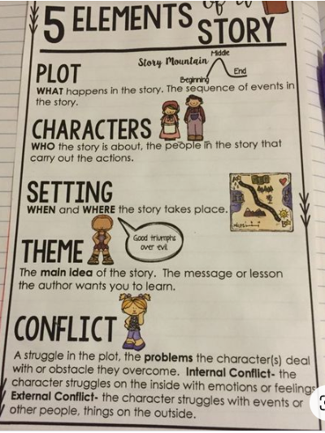
Activity
Watch the Brain Pop Jr. Video for Plot: https://jr.brainpop.com/readingandwriting/storyelements/plot/
Open your English notebook and copy the following notes:
BRAIN POP JR.
USER NAME: gimnasiocampestre
PASSWORD: campestre

Slide 19
Project
This term Project will be to write a story about what you will do once the quarantine is over.
Your story can include some fiction.
The main character should be you!
You will have to write it in the future simple.
Your story has to have the five parts of the plot. Just remember that on each part you will write a paragraph. So at the end you will have 5 paragraphs.
Your story also has to have the 5 elements of the story.
Don’t worry. In the following weeks we will do it step by step. You DON’T have to write your story now. Today we will just plan it.

Slide 20
Planning my story
Thinking about what you really want to do once the quarantine is over can really help you.
Complete the Plot Diagram for your story.
Make sure to fill out all the spaces.
Keep this paper in a safe place because we will be using it the following weeks.
We will be grading IM1 with this worksheet.
ENTREGABLE

Slide 21
Great work this week!!!!
Enjoy your weekend!

