Slide 1
Fractions with different denominators

Slide 2
Warm up: Reviewing Multiples
Which of the following numbers are multiples of 2?
13, 10, 4, 20, 51, 94, 22, 17, 6
13, 10, 4, 20, 51, 94, 22, 17, 6
Which number is the lowest multiple ?
4

Slide 3
What are the multiples of 4 and 8?
Multiples of 4 Multiples of 8
4, 8, 12, 16, 20, 24
8,16, 24, 32, 40
What are the common multiples of 4 and 8?
8, 16, 24
What is the least common multiple of 4 and 8?
8!

Slide 4
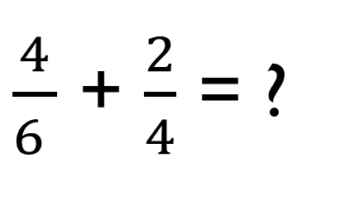
Look at the problem below…
$\frac{4}{6 }$ + $\frac{2}{4}$ = ?
Can we solve this operation? Why/why not?
What could we change to help us solve the problem?
THE DENOMINATOR!
But how…?

Slide 5
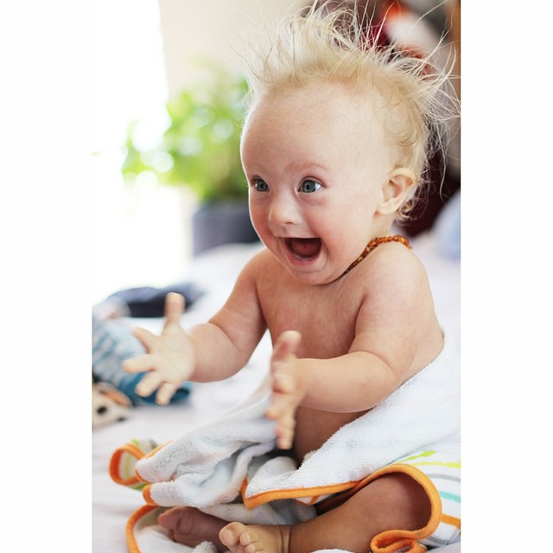

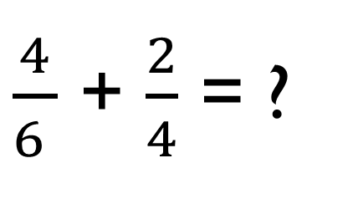
Finding the Lowest common denominator
If the denominators are different, we have to find the lowest common denominator for both fractions before we can solve our operations.
x2 x3
$\frac{4}{6 }$ + $\frac{2}{4}$ = ?
1. First, we list all the multiples of the two denominators.
Top Tip: Start with the biggest number first.
x2 x3
Circle the lowest common multiple
Multiply the denominators by the number needed to reach the lowest common multiple. Eg: 6 x 2 and 4x 3
6:
4:
6, 12, 18, 24, 30
4, 8, 12, 16, 20, 24, 28
4. Multiply the numerators by the same number that you used for the denominator. Eg. 4x 2 and 2 x 3
$\frac{8}{12 }$ + $\frac{6}{12}$ = $\frac{14}{12}$ or1$\frac{2}{12}$
5. Now you have your new fractions with the same denominator, you can complete the operation!

Slide 6

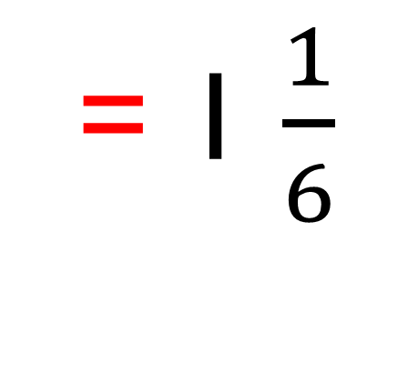
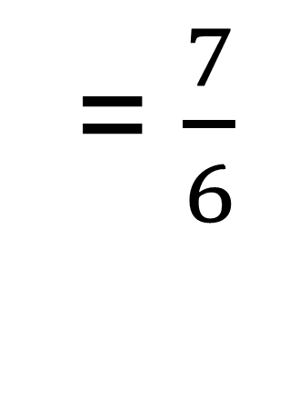
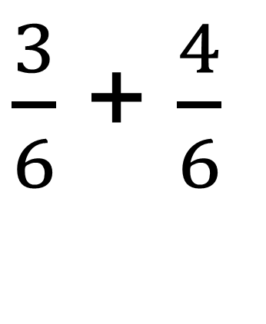
Practice…
$\frac{3}{6}$ + $\frac{2}{3}$
x1 x2
6:
3:
6, 12, 18
3, 6, 9, 12, 15
x1 x2
$\frac{3}{6}$ + $\frac{4}{6}$
= $\frac{7}{6}$
= 1 $\frac{1}{6}$

Slide 7
Wrap up:
With a partner, solve the problem as fast as you can in the back of a notebook:
Santiago has $\frac{1}{2}$ of a chocolate cake, and Jeronimo has $\frac{3}{6}$ of a chocolate cake. How much cake do they have in total?

