Slide 1
Flyers Class 4 – Week 3
Thursday April 2

Slide 2
Step 1: Guess what this is:
You eat them
you can cook them
they are often green
carrots are an example of them

Slide 3
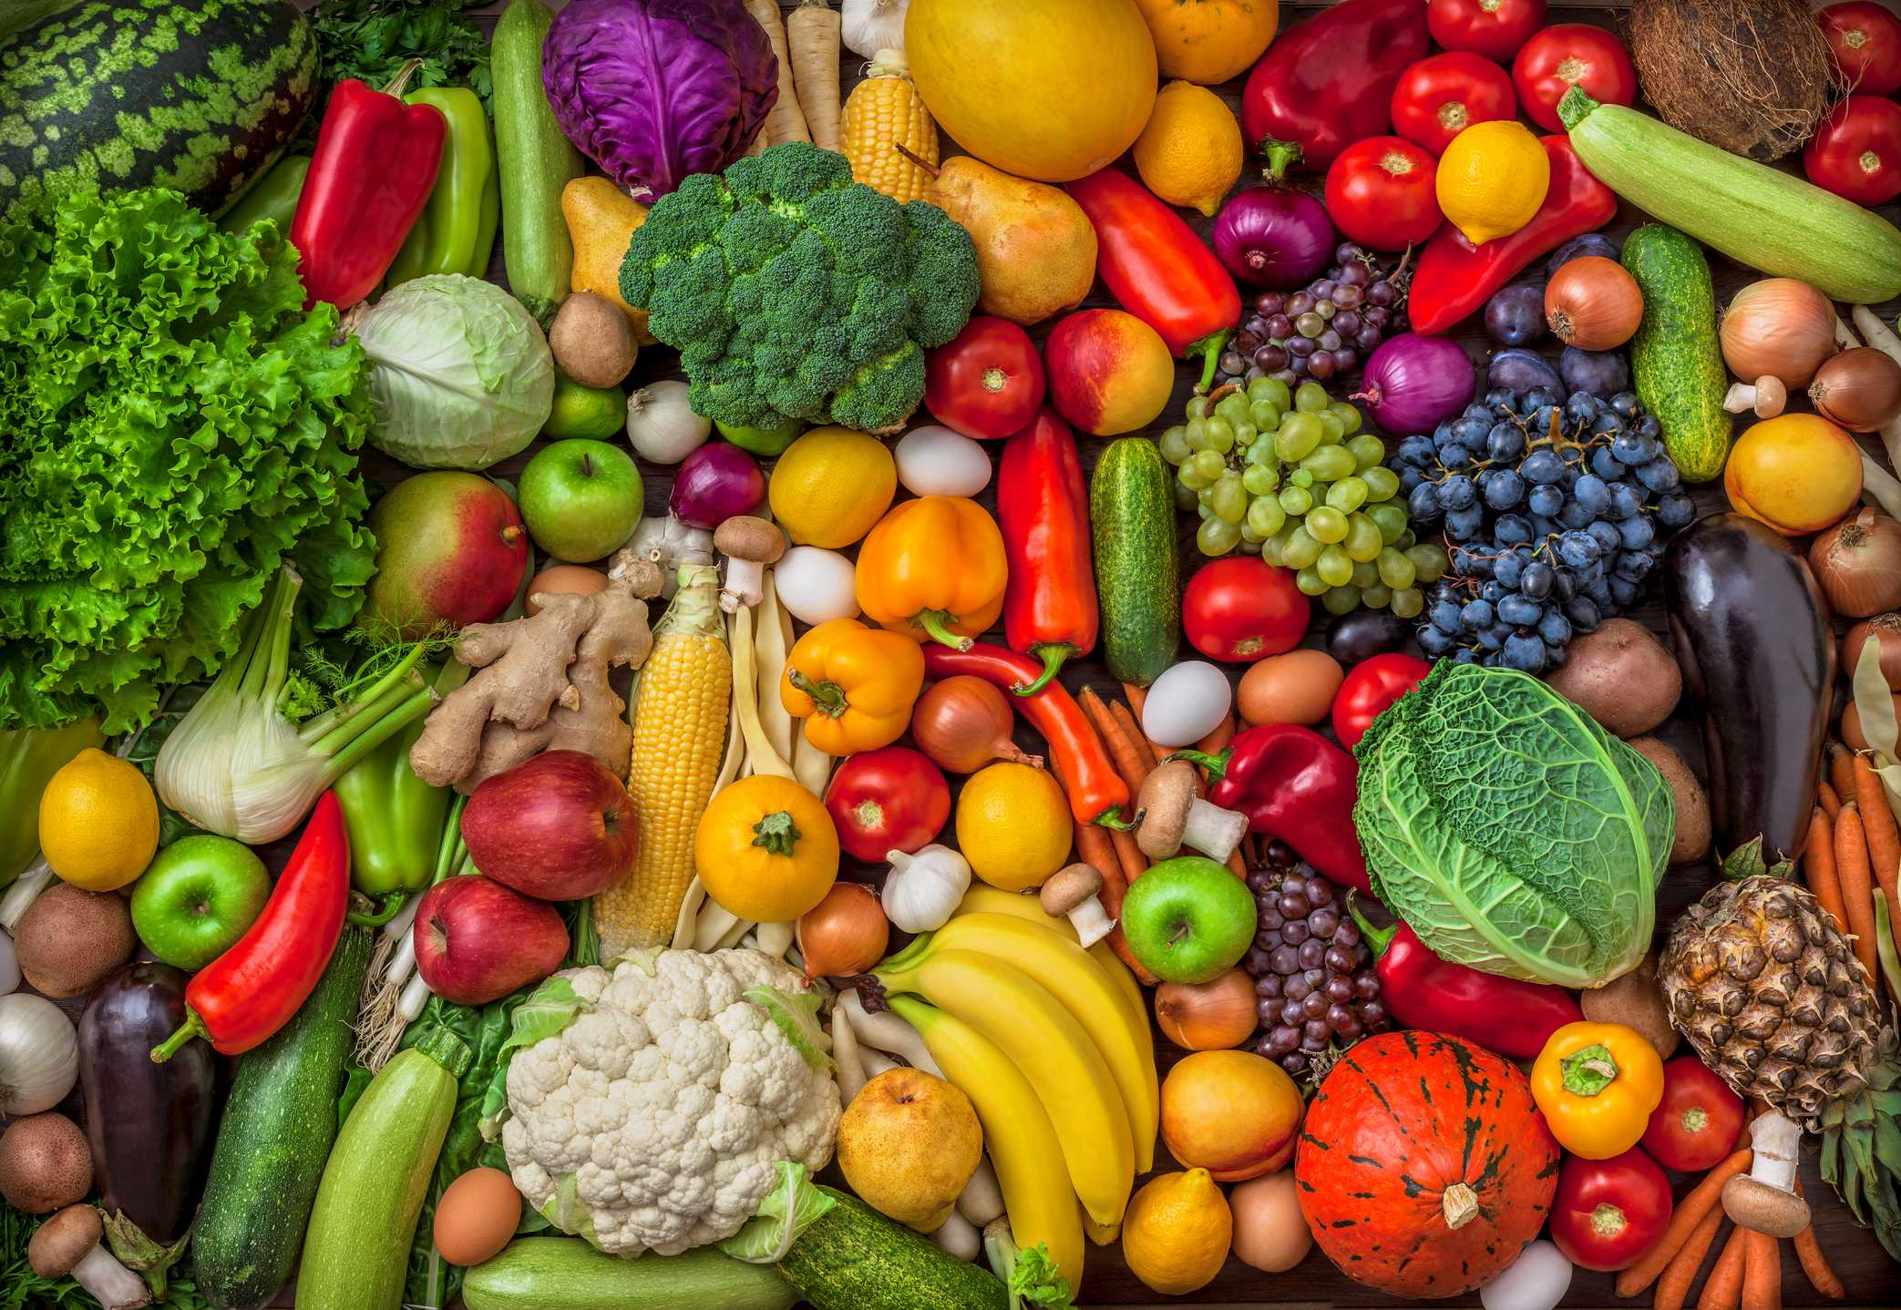
Vegetables!!!!

Slide 4
Guess what this is:
You can cut with this.
You find this in the kitchen.
You use it to eat food

Slide 5
Knife!!!

Slide 6
Guess what this is:
It’s a sport.
There are eleven people in a team.
Messi plays it.

Slide 7
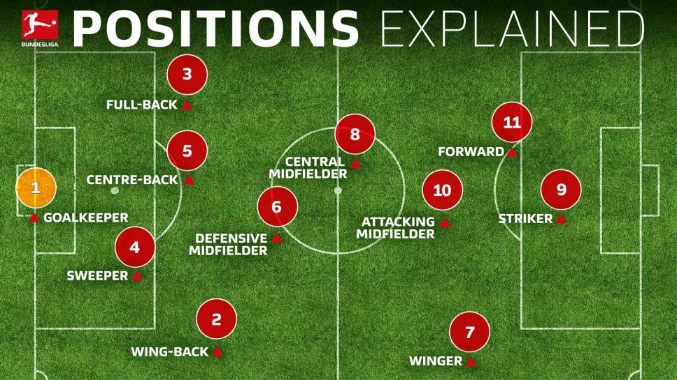
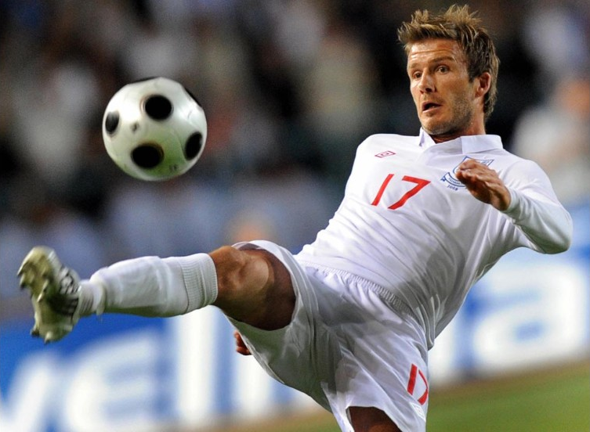
Football!!!

Slide 8
Guess what this is:
We wear them on our legs.
They are often blue.
They are like trousers.
They are comfortable clothes.
They are very popular.
You find them and see them everywhere.

Slide 9
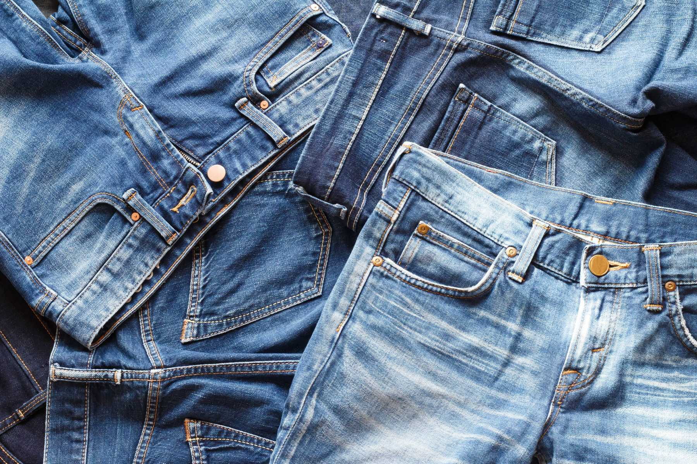
Jeans!!!!

Slide 10
You can use these sentences to describe objects:
You can …… with this/these
It’s/They’re made of ……
It’s/They’re often/very (+ adjective)
They’re like / They look like …….
You find this in/at ……

Slide 11
Step 2:
Click on the following link: https://www.cambridgeenglish.org/Images/young-learners-sample-papers-2018-vol1.pdf
Download and print page 77.
Check that it is the same one as the one in slide #15.
Complete the paper. Follow the instructions and the example (an austronaut, not astronaut)

Slide 12
Step 3:
Answer the following questions:
How many questions are there?
What do you have to do?
How many words are there?
How are these test questions different from the game you’ve just played?

Slide 13
How many questions are there? (10, plus one example)
What do you have to do? (choose the correct words and write them on the lines – I have to read the instructions at the top of the page)
How many words are there? (15, so 5 of them won’t be used)
How are these test questions different from the game you’ve just played? (the words and the definitions are both given – I don’t need to guess what I think the word is)

Slide 14
Step 4
Complete the worksheet.
Remember to copy the words clearly making sure they are easy to read
the spelling must be correct. You have to copy the words exactly as they are given on the page, For example:
a fridge (not fridges)
an apartment (not apartment)
cupboards (not a cupboard).

Slide 15
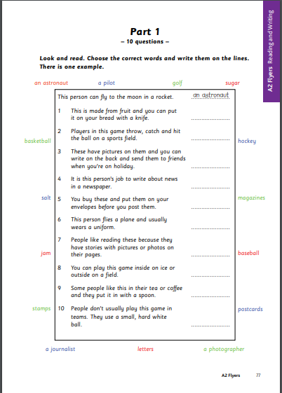

Slide 16
Step 5
Go to Weebly: https://thirdgradecampestre.weebly.com
Download the file: “Flyers Reading and Writing 1” (English / Term III / Week 3 Worksheets).
Compare and contrast your work.
Correct your work if you need to.

