Slide 1
Flyers Reading and Writing Part 4
Thursday May 21

Slide 2
Read at the following sentence and think if the verb is correct:
Doctors working in a hospital.
NO
Working is the wrong word. It should be work.
To be a sentence, there must be a main verb. Working is a participle and needs an auxiliary (are) to be a verb. In this sentence, we are talking about something which is always true, so we use the present simple.

Slide 3
Lets try it one more time
Find the wrong word in this sentence:
There are many doctors where want to help you.
The wrong word is: ?
The wrong word is where.
The relative pronoun should be who not where – who refers to a person, where to a place.

Slide 4
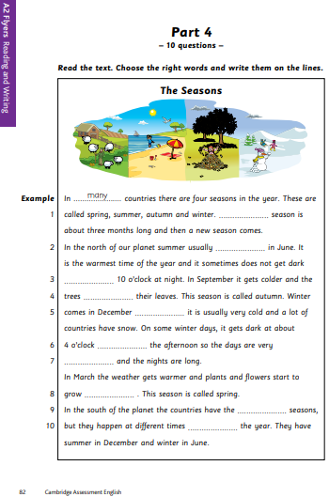
Part 4
In part 4 you will not have to think about vocabuary.
In this part you will have to think about grammar.
Take a good look to page 82. Now answer the following questions:
What is the title?
The Seasons
How many gaps (blanks) are there?
10 and 1 example
Now read the whole page without thinking about the spaces, but thinking on the general meaning of the text.
In part 4 you will be working with factual texts.
Download pages 82 and 83 here: https://www.cambridgeenglish.org/Images/young-learners-sample-papers-2018-vol1.pdf

Slide 5
Part 4
Now think of the possible answers for every blank space.

Slide 6
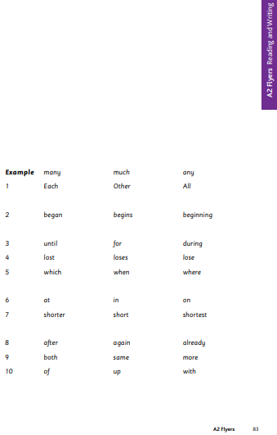
Part 4
In this activity you will have to look at the three possible answers, in page 83, for every blank space and try to choose the one that you think fits best.
Lets focus on the example:
Many is a determiner used with countable nouns (plural).
Much is a determiner used with uncountable nouns (plural), and often in the negative (not much money) and questions (Do you have much money?)
Any is a determiner used to talk about one of many, used with plural nouns.

Slide 7
Complete the activity
This three questions will help you while you choose the answers:
Is it singular or plural?
Past or present?
A person, thing or place?

Slide 8
Check your work
Season is singular.
This sentence is talking about a general fact, so it needs to be present simple
10 o’clock at night is a specific point in time.
This sentence is talking about a general fact, so it needs to be present simple. Gets colder helps us identify the tense too. Trees is the subject so we use lose not loses.
December refers to time, so we need to use when. It is followed by the subject it so we can’t use which.
4 o’clock is a specific time so we need the preposition at.
We are describing the days, not comparing them, so we need the adjective short. The nights are long also helps us as we need to use the same form of the adjective.
The plants and flowers already grew before, so this is a repeated action, so we need to use again.
The word but helps us see thee is contrast. The contrast is with different, so it has to be the same. The definite article the also helps as same is always preceded by it.
Times of the year is a fixed expression.

Slide 9
Check your answers
Each
begins
Until
lose
when
in
short
again
same
of

