Slide 1
Flyers – Reading and Writing
Part 6

Slide 2
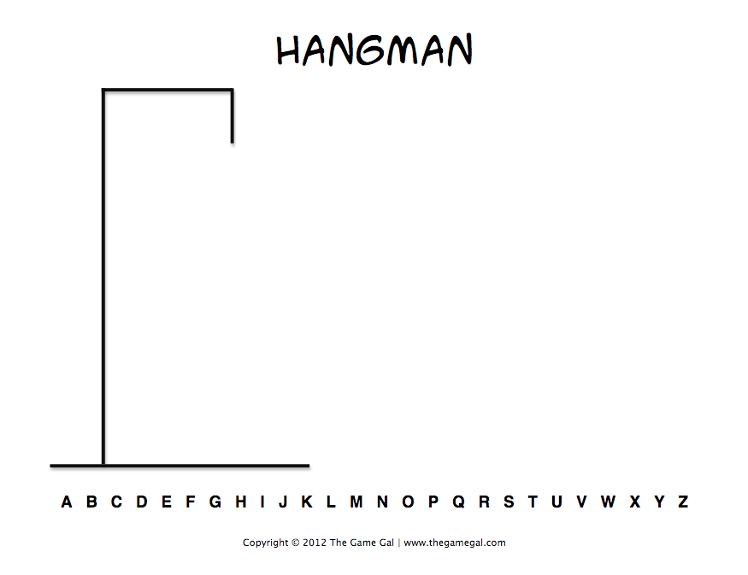
Lets play hangman!
Look at the image.
Try to guess what Word it is.
Count the number of guesses.
Now think about words that are related to the word photograph.
P
H
O
T
O
G
R
A
P
H
Take a photograph of something.
Take a photograph of someone.

Slide 3
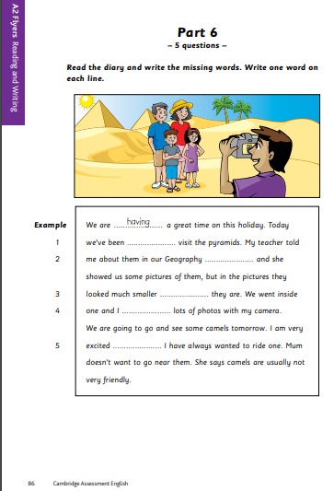
Activity
Download page 86 from the following link: https://www.cambridgeenglish.org/images/flyers-sample-papers-2018-vol1.pdf
Answer the following questions:
What kind of a text is this?
How many questions do you have to answer?
What do you have to do?
How many words do you write in each space?
Are there some words to choose from?
What do you think the letter is about?
What should you do first?
A diary.
5
Write a word in each space.
Only one.
No, you have to decide on the words by yourself.
Taking photographs / A trip / Vacations
Read the text once without thinking about the missing words, to get an overall understanding of the text.

Slide 4
Before filling the spaces think about…
Reading before and after the space before you decide.
Thinking about what kind of word is needed in the gap (verb, noun, preposition, etc.).
Thinking about the grammar clues, e.g. single/plural, present or past, verb patterns, etc.
Using the meaning of the whole sentence (or text) to help you.
Reading the letter through at the end to check.
Now you can complete page 86

Slide 5
Check Your Answers
to
Class(es)/lesson(s)/studies
than
took/got
because/as/since/and

