Slide 1
Math: Week 4
April 14-17th

Slide 2
Plan for the Week
On Friday, you will have an evaluation using Quizalize to assess IM1 and IM2
We will spend the week preparing for the evaluation using this powerpoint, your math notebook and your volume 2 book.
You will have Splash Learn practice assigned too. You should try to complete them. If you cant acess the platform or you dont like it, ask your teacher for a different mini practice.

Slide 3
Class 1
Tuesday 14th of April

Slide 4
For this class you will need:
Your volume 2 math book
A pencil and a coloured pencil
A computer to complete splash learn.

Slide 5
Task 1: Pages 681, 682, 683
Remember to read the questions carefully! Some of them have 2 different parts
Complete page 681:
You can check the place value chart in your notebook to help you remember what are tenths and hundredths!
2. Complete page 682:
If you need help remembering how to convert decimals into fractions you can look at page 653 to remind yourself!
If you need help with adding decimals and fractions look at page 665.
For help ordering and comparing decimals use the PowerPoint from last week (number line, models and place value).
3. Complete page 683: You only need to complete question 17 and question 20.

Slide 6
Task 2: Check your answers
Check your answers using Weebly. You can find them by going to: Weebly/Math/Trimester 3/Week 4/Class 1 Or using the link below:
https://thirdgradecampestre.weebly.com/week-4.html
Task 3: Splash Learn
Complete the assignment:
“Compare decimals greater than one”

Slide 7
All done! Well done, you did excellently!

Slide 8
Class 2
Wednesday 15th of April

Slide 9
For this class you will need:
Your volume 2 math book
Your math notebook
A pencil
This powerpoint to help you
Access to a computer for splash learn

Slide 10
Task One: page 684 pt 1
Find the table that you can see here on page 684
You have to convert fractions to decimals, and decimals to fractions to complete the table.
Example: Alpharetta has 0.7 inches of rainfall.
You have to write it as a fraction.
0.7 = 7/10! So you write 7/10 here.
3. Try to complete the rest of the table in 3 minutes. Set a timer if you can and complete it as quickly as possible (but make sure you answer correctly!)
4. When finished, go to the next page to check your answers.

Slide 11
Check your answers
Tick or correct your answers using this completed table!

Slide 12
Task 2: Page 684 pt2 Part C
Find the table you can see here.
For this task, you have to add the amount of rain on Thursday and Friday together.
EG: In Alpharetta it rained 0.7 inches on Thursday and 0.14 inches on Friday.
Remember to add the 0 to the 0.7 so we dont get confused!
0.70 + 0.14 = 0.84
So we write 0.84 here.
Complete the rest of the table
When you have finished, check your answers with the next slide.

Slide 13
Check your answers
Tick or correct your answers

Slide 14
Task 3: BrainPop Video
1. Watch the video “Decimals” on BrainPop
https://www.brainpop.com/math/numbersandoperations/decimals/
2. When you have finished, write the date and title in your math notebook
“When Do We Use Decimals?”
3. Using the information from the video, and your own knowledge, write a list of all the things we use decimals with.
Eg: We use decimals when we talk about money.
Think about all the word problems we have completed in the math book – those show the different uses of decimals.

Slide 15
Task 4: Splash Learn
Log into Splash Learn and complete the task:
“Order Decimals Less Than One”
Class is over for the day! Well done!!
Good work today ☺

Slide 16
Class 3
Thursday 16th of April

Slide 17
For this class you will need:
Your math notebook
A pencil
This powerpoint to help you
A computer to complete splash learn

Slide 18
Task 1: Practice Test
In this class we are going to practice some exercises very similar to the ones that will be in your evaluation tomorrow!
Each slide will ask you some questions. Work out the answer and write it in your math notebook. You do not need to write the question, but it is a good idea to show your working out.
Before we start: Write the date and todays title in your math notebook:
“Decimals and Fractions: Practice Quiz”

Slide 19
Get Ready…
Q1: 0.9 – 0.5 = ? (Write the answer as a fraction and a decimal)
Q2: 0.2 + 0.25 = ? (Write the answer in Word form)
Q3: 5/10 + 5/10 = ?
Q4: 0.20 + 3/10 = ? (Write the answer as a fraction and a decimal)

Slide 20
Keep going! You’re doing great!
Q5: Jacob ran 4/10 of a mile on Wednesday and 0.20 of a mile on Thursday. How much did he run in total?
Q6: Liza scores 5/10 on her math quiz and Jamie scores 8/10. How much more did Jamie score than Liza?
Q7: Lucy read 8/100 of her book, Mason read 0.77 of her book and Jenny read 7/10 of her book. Order the three numbers from GREATEST to LEAST

Slide 21
Task 2: Correct your answers
All finished! Well done!!
Now you are going to check your answers. On the next slide you will find all of the answers. Tick or correct your work.
When you have finished, look at your work and decide if you need to practice anything before the quiz tomorrow. Use last weeks powerpoint, your volume 2 and the videos on Weebly to help you.

Slide 22
Answers:
Q1: 0.9 – 0.5 = 0.4 or 4/10
Q2: 0.2 + 0.25 = 0.45 → Zero point forty five, or forty five hundredths.
Q3: 5/10 + 5/10 = One whole! (1.0 or 10/10)
Q4: 0.20 + 3/10 = 0.5 or 5/10.
Q5: Jacob ran 0.6 or 6/10 of a mile in total.
Q6: Jamie scored 3/10 or 0.3 more than Liza
Q7: 0.77 or 77/100 > 0.7 or 7/10 > 0.08 or 8/100

Slide 23
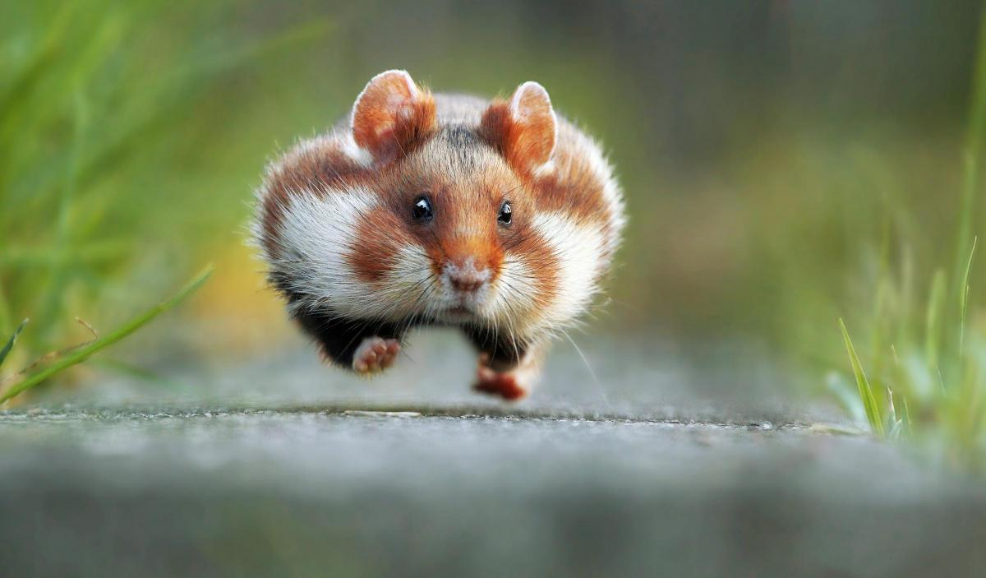
Task 3: Splash Learn
Your final task today is to log into Splash Learn and complete the assignment “Represent Decimals Greater than One”
Woohoooo Well done! All done for the day, now you can go and relax!

Slide 24
Class 4
Friday 17th of April

Slide 25
For this class you will need:
Your math notebook
Your metacognition chart
A pencil and coloured pencils
Access to a computer to complete the quiz on quizalize.

Slide 26
Task 1: Metacognition Chart
Take out your metacognition chart and re-read your strategies for improving.
Have you been using the strategies? Be honest!
Using a coloured pencil (red, yellow/orange or green) color the traffic light depending on how well it is going in the Week 4 Section.
Put your metacognition chart somewhere safe.

Slide 27
Task 2: Quizalize Quiz
You are now going to take your quizalize quiz. There are 10 questions, and they are multiple choice. Remember to read the questions very carefully, and take your time. You have 5 minutes per question.
Use your notebook to work out the answers, then choose the correct answer on Quizalize.
Go to the following link and take the quiz: “Decimals and Fractions Quiz IM1 and IM2” https://www.quizalize.com/
Click on Student Login and enter the Class Code: kqb4781
Choose your name from the list and take the quiz!
GOOD LUCK!

Slide 28
Well done!
We are all done for the week. Take a well deserved rest, and pat yourself on the back for all your hard work this week!

