Slide 1
Math Week 7
27th april – 1st of may
1st of may is a holiday

Slide 2
Class One:
For this class you will need:
Volume 2 Math Book
A ruler
A pencil
A computer for Splash Learn

Slide 3
Task 1: Introduction to measuring length
Open your math books to page 775 and read the definitions below:
Polygons are closed shapes with
There are 10 mm in a cm
There are 100 cm in a metre
There are 1000 m in a kilometre

Slide 4
Task 1: Introduction to measuring length
Look at Example 1 on Page 775 and complete it.
1. Follow the instructions to measure the carrot using your ruler. Remember to line up the 0 on your ruler with the end of the object you are measuring.
2. In this exercise you are not giving an exact measurement, you are rounding to the nearest centimetre.
Eg : The carrot is closer to 12 than 11, so the carrot is almost 12 centimetres long.

Slide 5
Task 1: Introduction to measuring length
Look at Example 2 on Page 776 and complete it.
It is always a good idea to make a guess (estimate) about which units of measurements we should use to measure an object.
To do this, look at the length of the object and ask yourself which unit of measurement makes the most sense (mm, cm, m, km)
Complete the example by choosing the best estimation for the length of the desk.

Slide 6
Task 2: measuring length
Complete the Guided and Independent practices on page 776-777. Measure the objects using your ruler. Remember to round the measurement to the nearest centimetre.
When you have finished, go to Weebly to check your answers.

Slide 7
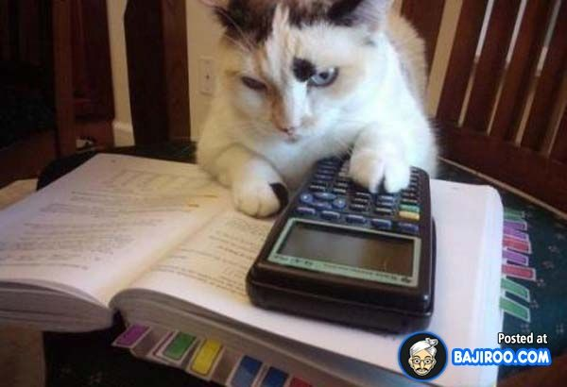
Task 3: Splash Learn (Optional)
Nearly done for the day! Log into Splash Learn and take the quiz
“Addition up to 100,000” to practice your addition skills! We will be using them next week!
Note: Splash Learn is having some technical difficulties so it might be a bit slow or show you some strange messages. You do not need to pay to complete assignments given to you by your teacher. Your teacher automatically receives the results and they will let you know if there is a problem. If your parents get a message to say you have not completed the work, but you already have, dont worry. They are having some problems with the system. If you dont want to use splash learn, don’t worry. This activity is OPTIONAL.
Great work today!

Slide 8
Class two: Measurement
For this class you will need:
Volume 2
Pencil
Ruler
A computer for Splash Learn

Slide 9
Task one: Problem Solving
Today you are going to complete page 778 and 780. You do not need to do page 779.
Some of the questions ask you to measure things in your classroom, or to estimate the length of you classroom. Use your bedroom or a different room in your house instead.
When you have finished, check your answers using Weebly.
Keyword: Reasonable – does it make sense? Is it possible?

Slide 10
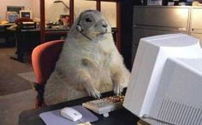
Task 2: Splash Learn (Optional)
Nearly done for the day! Log into Splash Learn and take the quiz
“Subtraction up to 100,000” to practice your subtraction skills! We will be using them next week!
Note: Splash Learn is having some technical difficulties so it might be a bit slow or show you some strange messages. You do not need to pay to complete assignments given to you by your teacher. Your teacher automatically receives the results and they will let you know if there is a problem. If your parents get a message to say you have not completed the work, but you already have, dont worry. They are having some problems with the system. If you dont want to use splash learn, don’t worry. This activity is OPTIONAL.
.
I can confirm you are 100% a genius!

Slide 11
Class three:
For this class you will need:
Your math notebook
A pencil
A ruler
A computer to watch 2 Youtube videos and complete Splash Learn

Slide 12
Task one: Reviewing Shapes
In this class we are going to review some very common shapes. To start off we will look at Quadrilaterals.
QUAD means four and LATERAL means sides = quadrilateral is a shape with four sides!
Watch this video to give you some more information on quadrilaterals
https://www.youtube.com/watch?v=WMkY_uIku9Q&t=42s

Slide 13
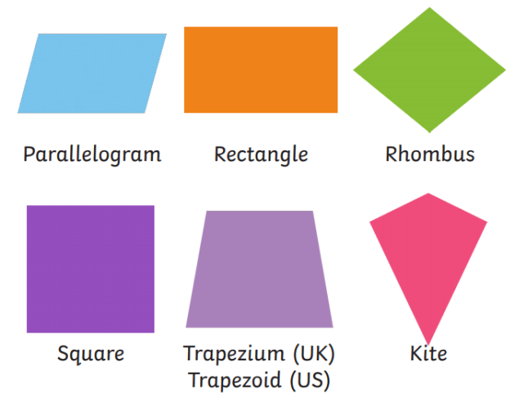
Task two: Notes on Quadrilaterals
Write the following notes down in your notebook, and copy the shapes with a ruler. Remember to write the date and the title:
Quadrilaterals
All quadrilaterals:
Have four sides and four corners.
Are closed shapes (all the sides join together)
The sides are straight lines.
All the angles inside add up to 360 degrees.
There are lots of different types of quadrilaterals, some examples are: squares, rectangles, trapeziums, rhombus and parallelograms. (Draw and label the examples)

Slide 14
Task three : Squares
Watch the following song all about squares: https://www.youtube.com/watch?v=jOr2eRBluUs&t=17s
Write the following notes down in your notebook. Draw the square using a ruler:
Squares:
A square has 4 sides. It is a quadrilateral.
Every side is equal in length.
Opposite sides are parallel
A square has 4 right angles (90°)
Right angles are the small squares in each corner

Slide 15
Task four: Splash Learn (Optional)
Nearly done for the day! Log into Splash Learn and take the quiz
“Addition up to 1,000,000” to practice your subtraction skills! We will be using them next week!
Note: Splash Learn is having some technical difficulties so it might be a bit slow or show you some strange messages. You do not need to pay to complete assignments given to you by your teacher. Your teacher automatically receives the results and they will let you know if there is a problem. If your parents get a message to say you have not completed the work, but you already have, dont worry. They are having some problems with the system. If you dont want to use splash learn, don’t worry. This activity is OPTIONAL.
.
Wow! How wonderful you are!

Slide 16
Class four:
For this class you will need:
Your math notebook
A pencil
A ruler
A computer to watch a Youtube video, and complete Splash Learn

Slide 17
Task One: Rectangle Video
Watch the following video about rectangles before we begin today. Rectangles are everywhere! How many rectangles can you see from where you are sitting now?
https://www.youtube.com/watch?v=2WHJio4TRNY

Slide 18
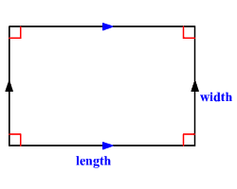
Task two : Rectangles
Write the following notes down in your notebook. Draw the rectangle using a ruler:
Rectangles:
A rectangle has 4 sides. It is a quadrilateral.
Each opposite side is equal in length.
Opposite sides are parallel
A rectangle has 4 right angles (90°)
Right angles are the small squares in each corner

Slide 19
Task three : Rectangles and Squares
Write the title: Rectangles and Squares Around the House
Take you notebook, pencil and ruler and go off searching in your house for rectangles and squares.
They are everywhere! When you find one, draw it in your notebook, write what the object is and measure the length and width. For example:
Repeat until you have 3 squares and 3 rectangles drawn in your notebook.
My TV.
It is a rectangle.
The length is 120cm and the width is 60 cm.

Slide 20
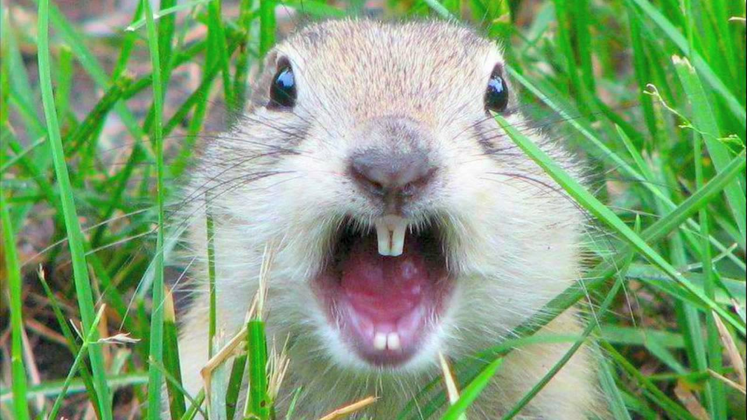
Task four: Splash Learn (Optional)
Nearly done for the day! Log into Splash Learn and take the quiz
“Subtraction up to 1,000,000” to practice your subtraction skills! We will be using them next week!
Note: Splash Learn is having some technical difficulties so it might be a bit slow or show you some strange messages. You do not need to pay to complete assignments given to you by your teacher. Your teacher automatically receives the results and they will let you know if there is a problem. If your parents get a message to say you have not completed the work, but you already have, dont worry. They are having some problems with the system. If you dont want to use splash learn, don’t worry. This activity is OPTIONAL.
I cant believe how many squares and rectangles are in your house!

