Slide 1
Math Week 8
May 4th -may 8th

Slide 2
Class 1
For this class you need:
A computer to watch Math Antics and BrainPop
A pencil
Your notebook
A ruler

Slide 3
Task One: Math Antics Video
Click on the link and watch the Math Antics video “Perimeter” on YouTube.
https://www.youtube.com/watch?v=AAY1bsazcgM

Slide 4
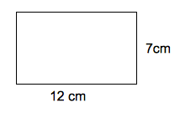
Task two: Making Notes
Write the date and the title in your notebook, then copythe following notes into your notebook. You can watch the video again to help you if you need to.
Perimeter
Perimeter means the distance or length around a shape.
To find the perimeter we add the length of each side of a shape.
The formula for perimeter for rectangles is P = L + L + W + W
For squares it is P = 4 x L (or L+L+L+L)
P = Perimeter, L = length and W = Width.
4. We must remember the units of measurement (cm, m, mm, km etc)
Example: The rectangle has a width of 7cm and a length or 12 cm.
To find the perimeter we add the measurements of all the sides ( L + L + W + W = P)
12+ 12 + 7 + 7 = 38.
So the rectangle has a perimeter of 38cm, or 38 centimetres

Slide 5
Task tHREE: BrainPop
Your next task today is to log onto BrainPopJnr and watch the video about Perimeter, when you have finished, take the hard quiz.
https://jr.brainpop.com/math/measurement/perimeter/
Remember, to find the perimeter of any polygon shape, you just have to add all the sides together. It doesnt matter if they have 3 sides or 18 sides! Add them together to find the perimeter.
Look at this shape. It has 5 sides.
To find the perimeter we add all the sides.
3 + 3 + 3 + 3 + 3 = 15cm.

Slide 6
Task four: Splash Learn
Log onto Splash Learn and complete the activity “Measuring Length – Metric Units.”
Well done! All finished for the day!

Slide 7
Class 2
For this class you need:
Volume 2 Math Book
Pencil
Computer to complete Splash Learn (Optional)

Slide 8
Task 1: Brain Teaser
Using your mental math skills, find the perimeter of the following shapes…
Remember: to find perimeter you add all the sides together.
Check your answers on the next page!
2cm
12cm
2cm
2cm
20cm
20cm
10cm
15cm
2cm
2cm
2cm
10cm
8cm

Slide 9
Task 1: Brain Teaser
Check your answers!
60cm
12cm
35cm

Slide 10
Task One: Perimeter with squares and rectangles.
Today you are going to be looking at rectangles and squares. It is important to remember the characteristics of these shapes. You do not need to write this down. Look at the example below of a rectangle:
We have a rectangle here, missing 2 measurements.
The width of one side is 3cm, and the length of one side is 6cm. How can we find the length and width of the missing sides? We can use our knowledge of rectangles to help us!
We know that rectangles have 4 sides. 2 of the sides are parallel and equal in length, and the other two sides are parallel and equal in width.
The length of one side is 6cm. The side parallel is ?. Using our knowledge of rectangles, the ? Must be 6cm too!
The width of the rectangle is 3cm, and the side parallel is ?. As they are parallel and in a regular rectangle, the ? Must be equal to 3cm!
So, ? = 6cm and ? = 3cm

Slide 11
Task One: Perimeter with squares and rectangles.
Today you are going to be looking at rectangles and squares. It is important to remember the characteristics of these shapes. You do not need to write this down. Look at the example below of a square:
Below we have a square. One side is labelled. We need to find the perimeter, but we are missing 3 sides. How can we do it? We can use our knowledge of squares to help us!
We know that squares have 4 sides., and 4 right angles (the small squares in the corner of the shape) and 2 sets of parallel lines. Looking at this shape, we can see it is a square as it has all those characteristics.
One side is 4m long. In a square, all the sides are equal in length, so the other sides must also be 4m long.
To find the perimeter we must add all the sides, or, if the shape is a square, we can multiple the sides by 4 (4 sides) . EG: 4 + 4+ 4 + 4 = P OR 4x 4= P
So, the perimeter is 16m!

Slide 12
Task Two: Finding the Perimeter of Squares and Rectangles.
Now it is your turn to find the perimeter! Open your Volume 2 books to page 826. You will be completing the “Guided Practice” on page 826 and the “Indepdent Practice” on page 827.
When you have finished, you should check your answers on Weebly.

Slide 13
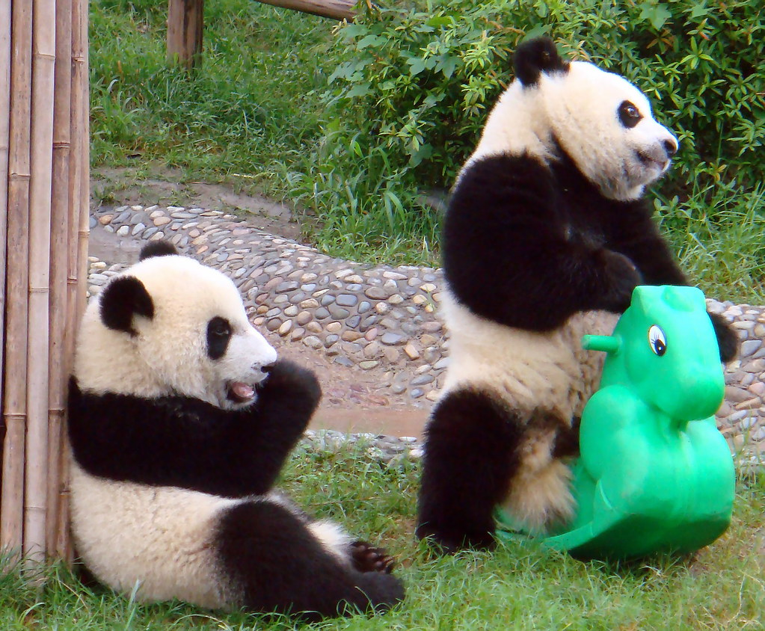
Task Three: splash Learn.
Log into Splash Learn and complete the activity “Perimeter of Non Regular Figures.”
All done for the day! Great job today!

Slide 14
Class 3
For this class you need:
Your math notebook
Printed worksheet “Finding the Perimeter”
A pencil
A ruler
A computer for Splash Learn

Slide 15
Task One: Brain teaser
You can write this down in your notebook, or do it in your head! It is up to you.
I have a square table in my living room. The total perimeter is 88cm. What is the length of one side?
Use what you already know about perimeter to help you find the length of one side.
P = L + L + L + L
Or for a square: P = 4 x L
When you think you have the answer, go to the next slide.

Slide 16
Task One: Brain teaser Answer
I have a square table in my living room. The total perimeter is 88cm. What is the length of one side?
Use what you already know about perimeter to help you find the length of one side.
P = L + L + L + L (Or for a square: P = 4 x L)
BUT what about if we already know the Perimeter? (WE DO THE OPPOSITE, P ÷ 4 = L! )
We know that the total perimeter is 88cm. So, 88cm = 4 x L
2. We already have the perimeter, so we do not need to multiply the lengths by 4, instead, we can DIVIDE by 4 to find the length of one side.
3. 88 ÷ 4 = 22. So, the length of one side is 22cm!

Slide 17
Task Two: Finding Perimeter of shapes (using decimals)
Today, you are going to be finding the perimeter of shapes. Some will be using decimals and some will be with whole numbers. You need the worksheet “Finding the Perimeter” to do this. If you can’t print the worksheet, you can copy the shapes into your notebook and solve them.
Remember: When adding and subtracting decimals you MUST line up your numbers carefully in place value, and the decimal places should all be lined up in the same place.
EG:

Slide 18
Task THree: Checking your answers.
Go to Weebly Week 8 to check your answers. If you got an answer incorrect, re check your work to find your mistake.
Task Four: Splash Learn.
Complete the assignment “Perimeter of Regular Figures” on Splash Learn.
You’ve completed everything for the day! Congratulations! ☺

Slide 19
Class 4
For this class you need:
Your math notebook
A pencil
A ruler
A computer to complete SplashLearn

Slide 20
Task One: Brainteaser.
Look at the shape below. What is the width of the rectangle?
When you have the answer, go to the next slide.
P =52.6cm
W = ? cm
L = 15cm

Slide 21
Task One: Brainteaster.
Look at the shape below. What is the width of the rectangle?
The perimeter is 52.6cm, and the length is 15cm.
We subtract: 52.6cm – 15 – 15 = 22.6cm.
22.6 is the length of TWO widths. To find the lenght of 1 width we must divide. 22.6 ÷ 2 = 11.3. So the width of one side is 11.3cm.
P =52.6cm
W = 11.3 cm
L = 15cm

Slide 22
Task two: Solving Word Problems about Perimeter.
Copy and solve the word problems and the table below into your notebook. Remember to write the date and the title
Solving Perimeter Word Problems
1. My notebook has a length of 12.5cm and a width of 8.8cm. What is the perimeter of the notebook?
Draw | Solve | Explain your process (step by step)
 | 8.8 8.8 12.5 + 12.5 --------------- Answer Sentence: | 1. First I draw and label my shape using a ruler. 2. Next, I write the lengths and widths (I make sure they are lined up in place value) I add the 4 numbers together. 4. I write my answer sentence and check I have included the units of measurement.
8.8cm
12.5 cm

Slide 23
Task two: Solving Word Problems about Perimeter.
Using the same table as for the previous problem, draw, solve and explain the following two Word problems.
Solving Perimeter Word Problems
2. The mirror in my bathroom is square. It has a perimeter of 48cm. What is the length of one side?
3. I have a rectangular poster with the perimeter of 108.4cm. The length of one side is 45cm. What is the width of one side?

Slide 24
Task tHree: Checking your answers
Check your answers to the word problems below:
1. My notebook has a length of 12.5cm and a width of 8.8cm. What is the perimeter of the notebook? The perimeter of my notebook is 42.6cm
2. The mirror in my bathroom is square. It has a perimeter of 48cm. What is the length of one side? The length of one side is 12cm.
3. I have a rectangular poster with the perimeter of 108.4cm. The length of one side is 45cm. What is the width of one side? The width of one side is 9.2cm.

Slide 25
Task 4: Splash Learn
Complete the assignment “Perimeter, Missing Side Lengths” on Splash Learn.
Well done, you completed Class 4! Great job!

Slide 26
Class 5
For this class you need:
Worksheet “Finding the Perimeter evaluation”
Pencil
Ruler
Computer for BrainPop

Slide 27
Task One: IM2 and CT2 Evaluation
Print the worksheet “Finding the Perimeter Evaluation” and complete it. You will send this back to your teacher in the entregas for this week.
Remember to use a ruler to draw your
Shapes.

Slide 28
Task 2: Introducing Area - BrainPop
Watch the BrainPop Jnr. video about area:
https://jr.brainpop.com/math/measurement/area/
Afterwards, take the hard quiz on BrainPop.
Well done! Everything is completed for the week! You did great!!!

