Slide 1
Math Week 9
Monday 11th – Friday 15th

Slide 2
Class One: Monday 11th
You will need:
A computer to watch Math Antics and SplashLearn
Your notebook
A pencil
A ruler

Slide 3
Task One: Math Antics Video
Watch the math antics video about area up until 4:48
https://www.youtube.com/watch?v=xCdxURXMdFY&t=15s
You do not need to watch the video about TRIANGLES. Only rectangles and squares.

Slide 4
Task Two: Making Notes about Area
Write the date and title in your notebook. Then copy down the notes. If you dont understand any of the notes, watch the math antics video again.
Calculating Area
When we find area we use “Squared Units of Measurement” We write the units of measurement, eg miles, and add a small “2” in the corner. Eg: 5m²
Formulas for rectangles and squares: Area = length x width (A=LxW)
To find the area of this rectangle, we multiply 4x2 = 8
So, the area is 8cm²
To find the area of this square, we multiply 3x3=9
So, the area is 9cm²
3 meters

Slide 5
Task Three: Practice time!
Under the same date and title, draw and label the following shapes in your notebook and work out the area. Remember the units of measuerements! Check your answers on the next slide.
1. This rectangle has a length of 10cm and a width of 3cm
3. This rectangle has a length of 13mm and a width of 2mm.
2. This square has a length of 6 meters
5. This rectangle has a length of 7cm and a width of 4cm.
4. This square has a length of 9cm

Slide 6
Task Three: Practice time!
Check your answers!
Area =
26mm²
Area =
30cm²
Area =
36m²
Area =
81cm²
Area =
28cm²

Slide 7
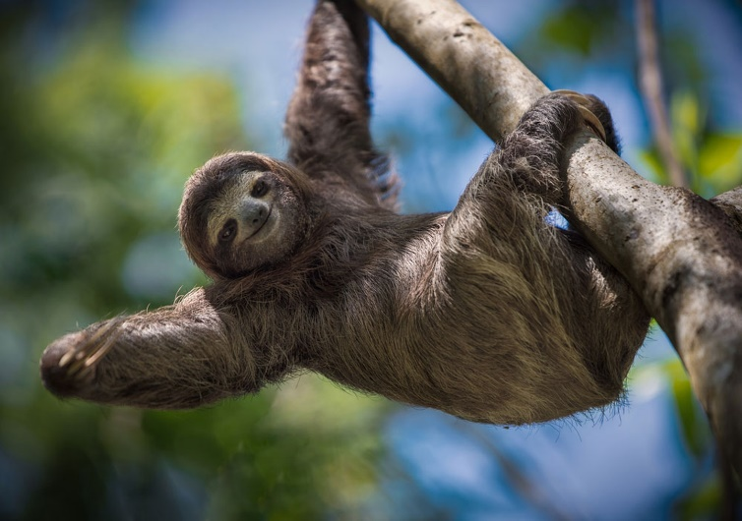
Task Four: Splash Learn
Complete the activity in Splash Learn “Identifying Quadrilaterals”
ALL DONE! Well done you have finished everything for Math!
Time to go hang out friends!

Slide 8
Class Two: Tuesday 12th
You will need:
Volume 2 math book
Pencil
Ruler
Computer for Splash Learn.

Slide 9
Task 1: Counting the Area
Go to page 839 and look at table below. We need to find the area of the rectangles by counting the square units (little squares inside each shape)
Lets look at the first shape together.
We can count the squares that make up the length. There are 4.
The width is just one square.
So, the area must be 4x1 = 4 squared units.
OR 4 units²
Complete the rest of the table! Check your answers on the next slide when you are finished.

Slide 10
Task 1: Counting the Area
Check your answers!

Slide 11
Task 2: Finding the Area
For this task, you are going to complete pages 841 and 842 in your Volume 2 Math book.
Page 841 is very similar to the activity you just did, except this time you might have to draw the shape, or find the missing length or width.
On Page 842 you are going to be solving some word problems. Make sure you read the questions really carefully.
You can check your answers on Weebly when you have finished!

Slide 12
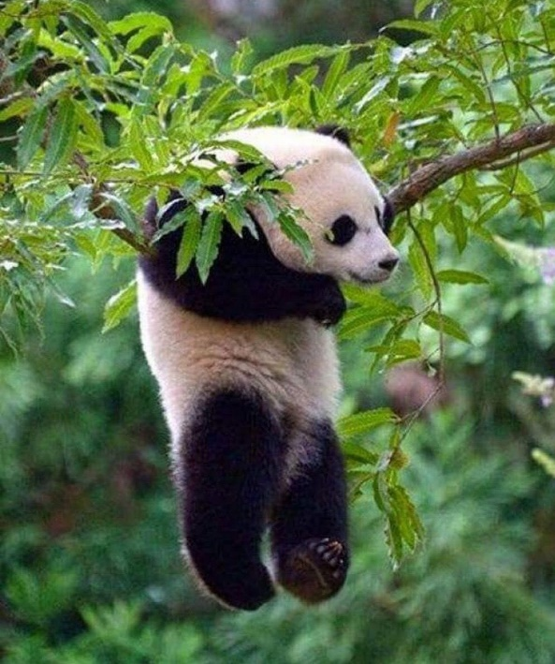
Task 3: Splash Learn
Complete the assignment “Area” on Splash Learn.
Well done! Tuesdays math class is finished! Time to relax…
Don’t mind me, I’m just chilling!

Slide 13
Class Three: Wednesday 13th
You will need:
Your math Volume 2
A pencil
A ruler.

Slide 14
Task 1: Brainteaser.
My alarm clock is a rectangle shape. It has an area of 72cm². The width is 8cm. What is the length?
Check your answer on the next page…
Well I know that A = L x W.. So I have to do the opposite operation…

Slide 15
Task 1: Brainteaser.
My alarm clock is a rectangle. It has an area of 72cm². The width is 8cm. What is the length?
Well I know that 72cm ² is the area, and one of the sides is 8cm.
So I need to do the following operation:
72 ÷ 8 = ?
Or
8x ? = 72
I could count my 8 times tables until I reach 72!!
So the answer must be 9cm!
Because 9 x 8 = 72!

Slide 16
Task 2:Practice!
For this task you will complete 3 pages in your math volume 2 book.
Page 846, 847 and 858
Remember to read the question carefully, on page 858 you will jhave to find the perimeter and the área.
When you have finished, you can check your answers on Weebly.

Slide 17
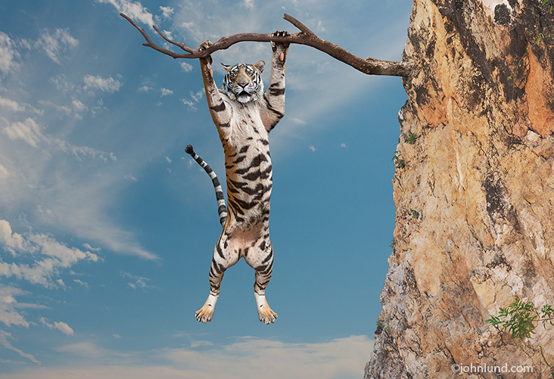
Task 3: Splash Learn
Complete the task “ Area of Simple Figures” on Splash Learn.
Woohoo! Everything is finished for today. Well done!
Already halfway through the week! Nearly there!

Slide 18
Class 4: Thursday 14th
You will need:
Printed worksheet “Finding the Area of Quadrilaterals”
A pencil
A Computer for Splash Learn

Slide 19
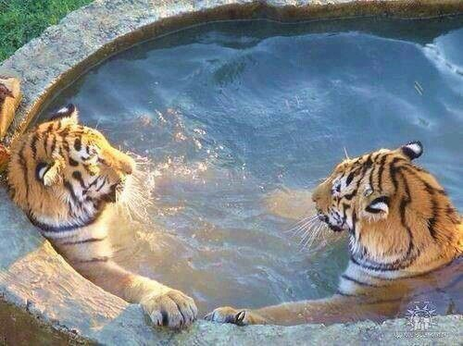
Task 1: Brainteaser
Jamies garden has an area of 25m². He installs a jacuzzi which has an area of 5m². How much free space (area) does he have left in his garden?
When you have the answer go to the next slide.
Turn on the bubbles please!

Slide 20
Task 1: Brainteaser
Check your answer!
Jamies garden has an area of 25m². He installs a jacuzzi which has an area of 5m². How much free space (area) does he have left in his garden?
There is 20m² of free space left!
Excellent! Just enough space for a swimming pool!

Slide 21
Task 2: Calculating Area
For todays task you are going to complete a worksheet all about area.
Remember to include your units of
measurement!
Check your answers using weebly
When you have finished.

Slide 22
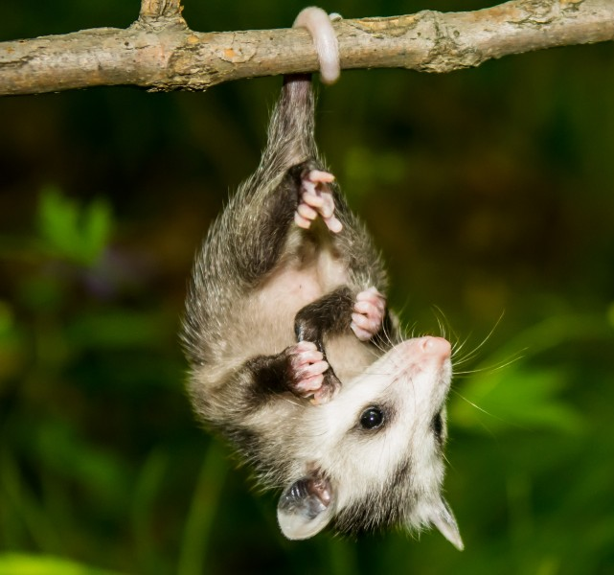
Task 3: Splash Learn
Complete the assignment “Area with Complex Figures”
Great job today! Keep up the good work ☺
Friday is so close I can almost taste it!!!

Slide 23
Class Five: Friday 15th
You will need:
Finding Perimeter and Area worksheet.
A pencil
A ruler
A computer for Splash Learn

Slide 24
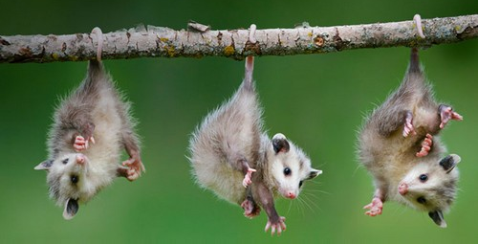
Task 1: Brainteaser
Emily has a picture frame on her wall. The picture frame has an area of 124cm ² (Blue rectangle). She puts a picture inside the frame. The picture has a length of 10cm and a width of 6cm (Green rectangle). How much free space (area) is left in the picture frame?
Go to the next slide to check your answer.
Hmm lets see, first we have to find the area of the picture!
Then we can subtract the area of the picture, from the area of the frame!

Slide 25
Task 1: Brainteaser
Check your answer!
First we found the area of the picture. 10 x 6 = 60cm². So the area is 60cm²
Then we subtracted the area of the picture from the area of the frame:
124cm² - 60cm²
Which gave us the answer… there is 64cm² of space left!

Slide 26
Task 2: Area and perimeter
For this task you will complete the
Worksheet called “Finding the Perimeter and Area”
If you are confused with the last question, have a look at the answer of the brainteaser, the little mice explain all the steps you need to take!
When you have finished, you can check your answers on Weebly.

Slide 27
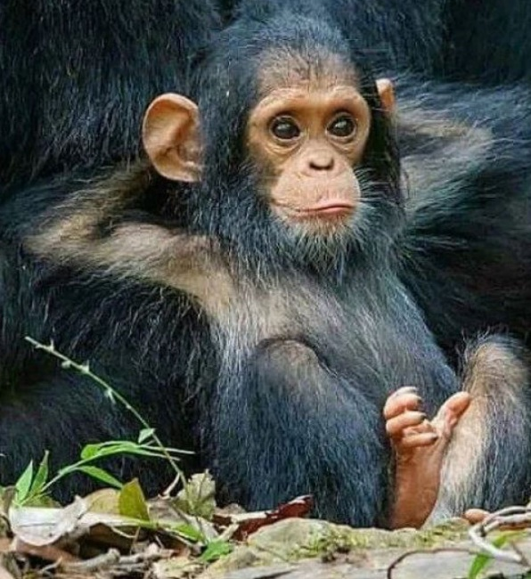
Task 3: Splash Learn
Complete the activity “Perimeter of Simple Figures”
Annnnnd relax! You have sucessfully reached Friday! What a brilliant week, well done!
I am the master of all things math.

