Slide 1
Math – week 6
20-24th of April

Slide 2
Class One
20th of April
For this class you need:
Your math notebook
A pencil
A computer for BrainPop

Slide 3
Class One : When do we use decimals?
This class we are going to look at when we use decimals in daily life. Last week, in class 2 you watched a brain pop video and made some notes in your notebook. If you can’t remember here are the instructions for last weeks class!
Go to the page in your notebook where you wrote your notes. If you didn’t write any notes, watch the brain pop video again (link below) and make notes before moving onto the next slide.
https://www.brainpop.com/math/numbersandoperations/decimals/

Slide 4
Task One: When do we use decimals?
Check your notes with the answers below. If you missed any, write them down in your notebook and copy the examples. Maybe you have extra ideas, that is perfect! These are just a few listed below
When do we use decimals?
We use decimals when we talk about money EG 4 dollars and 25 cents = 4.25
We use decimals when we talk about time EG 12 minutes and 33 seconds = 12.33
We use decimals for measuring weight EG she weights 67.2 kilograms.
We use decimals for measuring distances EG Gimnasio Campestre is 16.5 kilometres from my house.
We use decimals for measuring temperature EG On the 16th of July last year it was 31.4 degrees Celsius in England!
We can use decimals when we talk about things that are less than a whole, the same with fractions EG: I have a loaf of bread. It has 10 slices. Each slice is 0.1 of the loaf of bread. Although this is not as common, we usually use fractions instead.

Slide 5
Task two : Units of Measurement
Write the date and the title in your notebook. Then match the key words in red, to the units of measurement in black. Copy them into your notebook
Units of Measurement and Decimals
Time
Temperature
Distance
Weight
Money
Miles, kilometres, centimetres, metres, yards, inches, millimetres
Kilograms, grams, stone, pounds, tons
Dollars and cents , pesos, euros and cents, pounds and pennies
Degrees Celsius/centigrade (°C) or degrees Fahrenheit (°F)
Hours, minutes, seconds, months, years, decades.
Go to the next page to check your answers

Slide 6
Task two : Keywords for Decimal Problems
Check and Correct your answers!
Units of Measurement and Decimals
Time: Hours, minutes, seconds, months, years, decades.
Temperature: Degrees Celsius/centigrade (°C) or degrees Fahrenheit (°F)
Distance: Miles, kilometres, centimetres, metres, yards, inches, millimetres
Weight: Kilograms, grams, stone, pounds, tons
Money: Dollars and cents , pesos, euros and cents, pounds and pennies

Slide 7
Task three: Brain pop Video
1. Watch the brain pop video Grams and Kilograms : https://jr.brainpop.com/math/measurement/gramsandkilograms/
2. When you have finished, take the hard quiz.

Slide 8
Class two
21st of April
For this class you need:
Your math notebook
A pencil
A computer for BrainPop

Slide 9
Task one: Looking at decimal Word Problems
On this page you will see some examples of word problems using decimals. You do not need to write these down. Just follow the instructions.
“Elena runs 2.5 miles on Tuesday. On Wednesday she runs 3.1 miles. How many miles does she run altogether? “
“On Monday it was 31.4 degrees Celsius in Cartagena. It was 23.4 degrees Celsius in Medellin. How much hotter was it in Cartagena than Medellin? “
Look at the two word problems above and think about the following questions:
1. What type of word problem is it? (addition, subtraction or comparison)
2. What is the context? (money, distance, temperature, weight, time or other)
3. What are the units of measurement? (miles, dollars, metres, degrees Celsius, kilometres, seconds etc)
4. What is the number sentence and answer? (you may need to use your notebook to work out the answer)
When you think you know the answers to the questions above, go to the next slide to check.

Slide 10
Task one: Looking at decimal Word Problems
On this page you will see some examples of word problems using decimals. You do not need to write these down. Just follow the instructions.
Elena runs 2.5 miles on Tuesday. On Wednesday she runs 3.1 miles. How many miles does she run altogether?
What type of word problem is it? It is an addition word problem (altogether is the key word)
What is the context? The context is distance. (miles is the key word)
3. What are the units of measurement? The units of measurement are miles
4. What is the number sentence? 2.5 + 3.1 = 5.6
“On Monday it was 31.4 degrees Celsius in Cartagena. It was 23.4 degrees Celsius in Medellin. How much hotter was it in Cartagena than Medellin? “
What type of word problem is it? It is subtraction word problem
What is the context? The context is temperature. (degrees Celsius is the keyword)
3. What are the units of measurement? The units of measurement are degrees Celsius
4. What is the number sentence? 31.4-23.4 = 8.00

Slide 11
Task Two: Writing a word Problem
In your notebook, write the title and the date. You are going to write two word problem using the pictures below to help you. Write the word problem in your notebook. Check your spelling and that you have the correct units of measurement. Check your word problems with the next slide.
Writing a word problem
Number One: Write a problem about Emily swimming.
Number two: Write a problem about James going to the mall.

Slide 12
Task two: Writing a word problem
Look at the example word problems you see below. Yours might be a little different.
Question One:
Emily swims for 8.44 minutes on Saturday, and for 9.12 minutes on Sunday. How long does she swim for in total?
Emily swims for 8.44 minutes on Saturday, and for 9.12 minutes on Sunday. How much time does she swim for on Saturday and Sunday in total?
Keywords are written in purple – remember you MUST have units of measurement. (minutes!)
Phrases that are INCORRECT: How many time, what time does she swim. Correct these mistakes!
Question Two:
James has ten dollars ($10.00) he goes to the mall and buys a blue tshirt for four dollars and 50 cents ($4.50) How much money does he have left?
James spent four dollars and 50 cents ($4.50) on a Tshirt. He paid with ten dollars ($10.00) How much money does he have left? Or how much change did he receive?
Phrases that are INCORRECT: How many money, what money does he have Correct these mistakes!

Slide 13
Task three: Brain pop Video
1. Watch the brain pop video Temperature:
https://jr.brainpop.com/math/measurement/temperature/
2. When you have finished, take the hard quiz.

Slide 14
Class three
22nd of April
For this class you need:
Your math notebook
A pencil
A computer to watch Brain Pop

Slide 15
Task one: Brain pop Video
1. Watch the brain pop video: Centimetres, Meters and Kilometres:
https://jr.brainpop.com/math/measurement/centimetersmeterskilometers/
2. When you have finished, take the hard quiz.

Slide 16
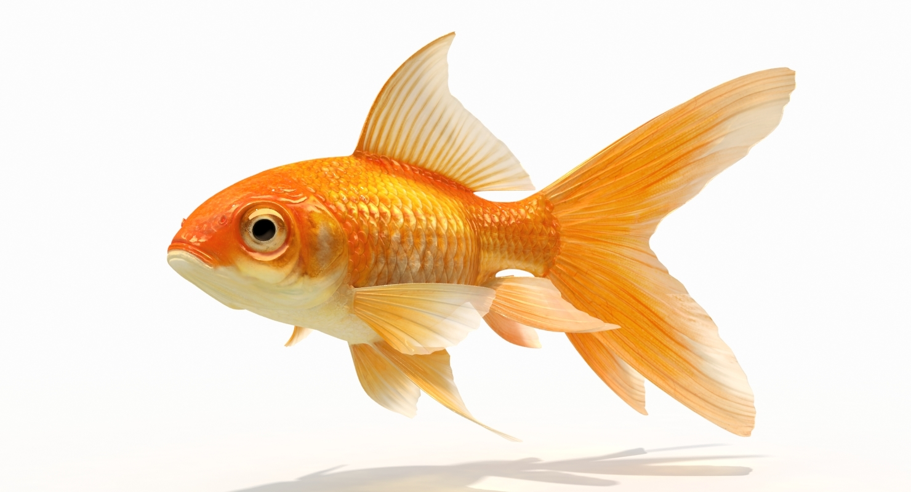
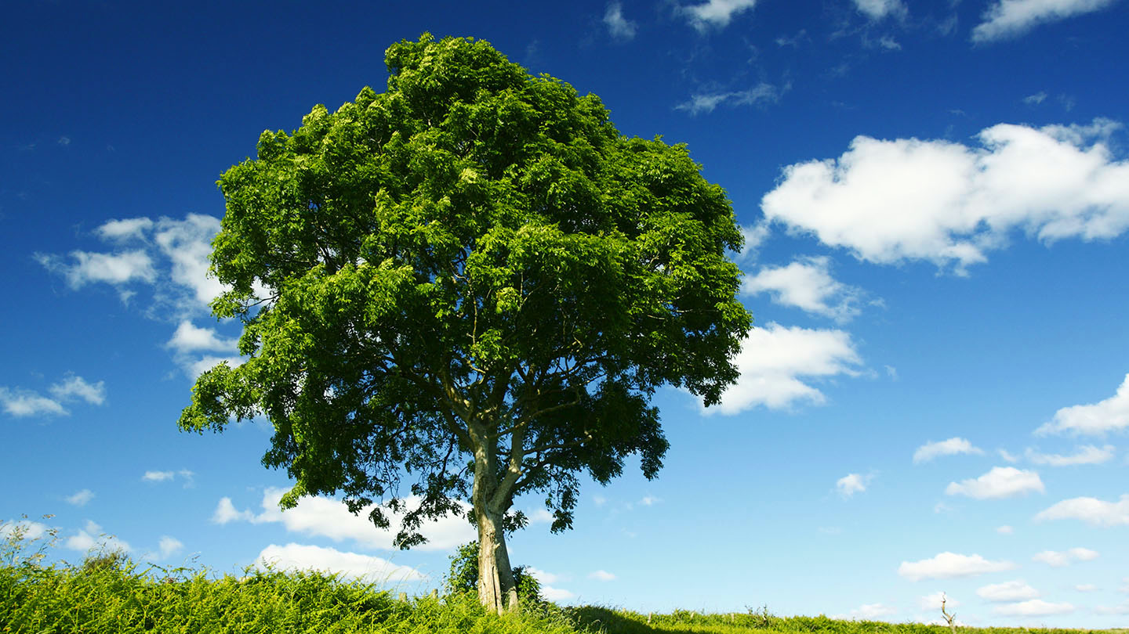
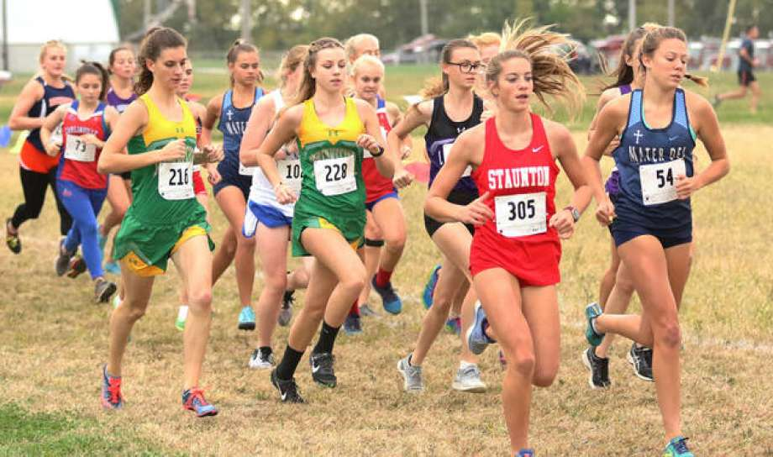
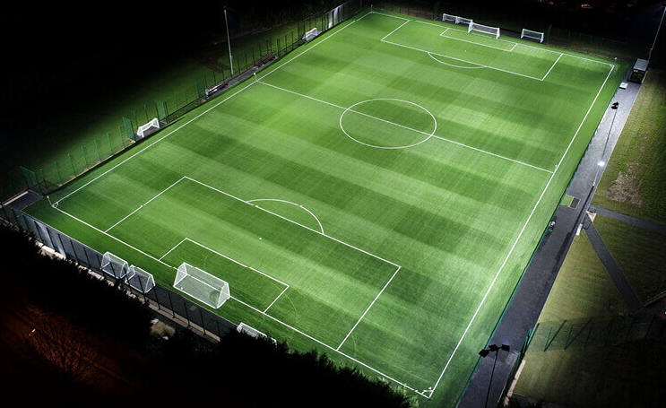
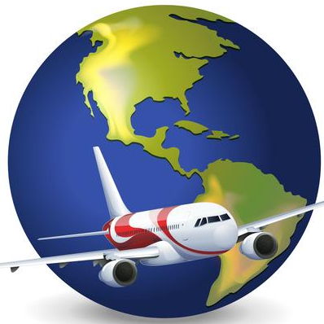
Task two: Centimetres, Meters and Kilometres
Write the date and title in your notebook. Next, draw or write each image into your notebook and decide if it should be measured in centimetres, meters or kilometres. An example has been completed for you. Check your answers on the next page.
Identify : Centimetres, Meters and Kilometres?
Example: A goldfish. Measured with centimetres (cm)

Slide 17
Task two: Centimetres, Metres and Kilometres
Write the date and title in your notebook. Next, draw or write each image into your notebook and decide if it should be measured in centimetres, meters or kilometres. An example has been completed for you.
Identify : Centimetres, Metres and Kilometres?
Example: A goldfish. Measured with centimetres (cm)
A tree, measured in metres.
Example: A marathon. Measured in kilometres
A candle. Measured in centimetres
Soccer pitch. Measured with metres
A plane journey. Measured in kilometres

Slide 18
Class Four
23rd of April
For this class you need:
Your math notebook
A pencil
A computer Brain Pop

Slide 19
Task one: Solving and checking word problems
Open your notebook and write the date and title. Then, copy down the word problem, solve it and then check with the opposite operation. When you have finished, write your answer sentence and check your answers on the next slide.
Solving and Checking Word Problems with Decimals
Juan Antonio played video games for 12 minutes and 43 seconds on Monday. On Tuesday he played for 21 minutes 32 seconds. How much time did he play for in total?
Solve with : _________________ | Check with ________________
Answer sentence:

Slide 20
Task one: Solving and checking word problems
CHECK YOUR ANSWERS
Solving and Checking Word Problems with Decimals
Juan Antonio played video games for 12 minutes and 43 seconds on Monday. On Tuesday he played for 21 minutes 32 seconds. How much time did he play for in total?
Solve with : Addition | Check with Subtraction
12.13 +21.22 __________ 33.35 | 33.35 -21.22 __________ 12.13
Answer sentence: Juan Antonio played for 33 minutes and 35 seconds (or 33.35 minutes) in total.

Slide 21
Task one: Solving and checking word problems
Next word problem! Copy down the word problem, solve it and then check with the opposite operation. When you have finished, check your answers on the next page.
Solving and Checking Word Problems with Decimals
When Santiago was born, he weighed 3.7kg. When Santiago was ten years old, he weighed 29.8kg. How much more did he weigh on his tenth birthday?
Solve with | Check with
Answer Sentence:

Slide 22
Task one: Solving and checking word problems
Next word problem! Copy down the word problem, solve it and then check with the opposite operation. When you have finished, check your answers on the next page.
Solving and Checking Word Problems with Decimals
When Santiago was born, he weighed 3.7kg. When Santiago was ten years old, he weighed 29.8kg. How much more did he weigh on his tenth birthday?
Solve with | Check with
29.8 - 3.7 _________ 26.1 | 26.1 + 3.7 _________ 29.8
Answer Sentence: Santiago weighs 26.1 kg more on his tenth birthday than when he was born.

Slide 23
Task 2: Create a word Problem and Solve it
Using the images below, create a word problem in your notebook. Then solve and check your answers using the table from task one.
My word problem: ______________________________________________________________________
Solve with _________________ | Check with _________________
Answer Sentence:

Slide 24
Task Three: Brain pop Video
1. Watch the brain pop video Millilitres and Litres :
https://jr.brainpop.com/math/measurement/millilitersandliters/
2. When you have finished, take the hard quiz.

Slide 25
Class five
24rd of April
For this class you need:
Your math notebook
A pencil
Your math evaluation →
Your metacognition chart.

Slide 26
Task One: metacognition Chart Complete the chart and send it in the pdf with the rest of your work. M1 and m2
Step one: Take out your metacognition chart and complete the traffic lights for week 5. All weeks should now be completed.
Step two: Look at the traffic lights for each strategy and use that information to answer the questions at the bottom of chart.
Something you feel confident with (Green traffic light)
Something you still need to work on (red or yellow traffic light)
How you will improve it
When finished, take a picture using CAMSCANNER and send it with the PDF of work on Sunday to your teacher

Slide 27
Task two: evaluation ct1, ct2 and c2
Write your name and the date on the evaluation. To complete part one you need to look at the images below of Jimmy. When you have finished, check your work and then take a photo using CAM SCANNER to include the evaluation in the PDF to be uploaded to phidias.
Use this image to write your word problem in part one of the evaluation.

