Slide 1
Mixed Numbers and Improper Fractions

Slide 2
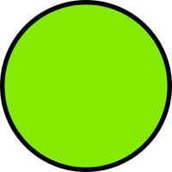
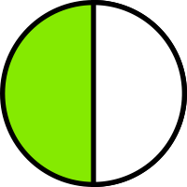
Jenny has $\frac{1}{2}$ of a candy bar and Jessica has $\frac{1}{2}$ of a candy bar. How much candy bar do they have in total?
$$\frac{2}{2}$$
$\frac{1}{2}$ + $\frac{1}{2}$ =
$\frac{2}{2}$ is equal to 1 whole.
Jenny and Jessica have 1 whole Candy bar in total.

Slide 3
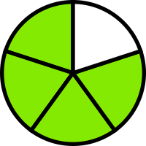
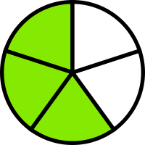
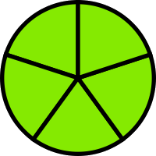
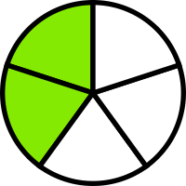
Sally eats $\frac{4}{5}$ of a banana. Jack eats $\frac{3}{5}$ of a banana. How much of a banana do they eat in total?
$\frac{7}{5 }$ or 1 $\frac{2}{5 }$
$\frac{4}{5}$ + $\frac{3}{5}$ =
+
=

Slide 4
Improper Fractions and Mixed numbers
An improper fraction is when the numerator is bigger than the denominator.
For example: $\frac{4}{3}$ . Draw a model of $\frac{4}{3}$
A mixed number is when a whole number is combined with a fraction.
For example: 1 $\frac{1}{3}$ . Draw a model of 1 $\frac{1}{3}$
$\frac{4}{3}$ and 1 $\frac{1}{3}$are equal

Slide 5
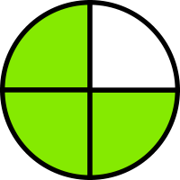
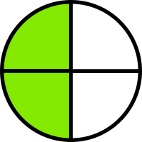
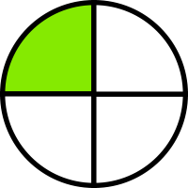
Improper fractions and Mixed numbers: With models.
In your notebooks draw the models below:
+ =
Label the models with the fractions…
$$\frac{3}{4} + \frac{2}{4}$$
1 $\frac{1}{4}$ or $\frac{5}{4}$

Slide 6
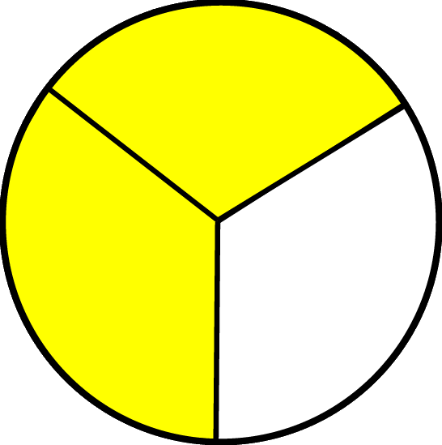
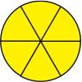
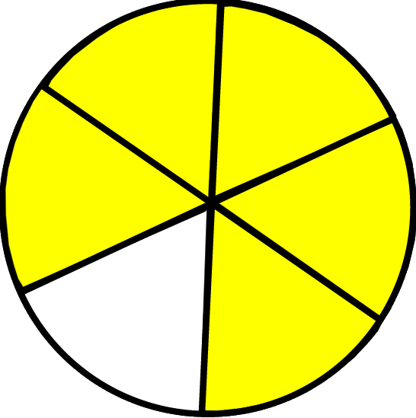
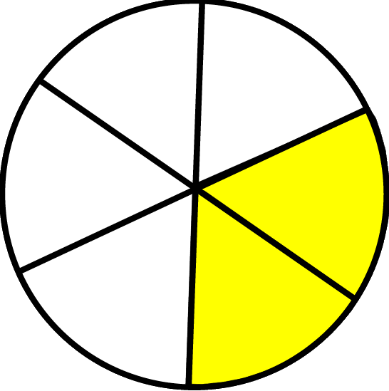
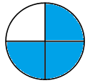
Practice…
1.
+ =
2.
+ =
3.
+ =

Slide 7
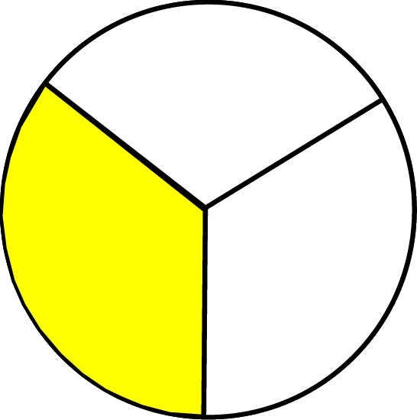
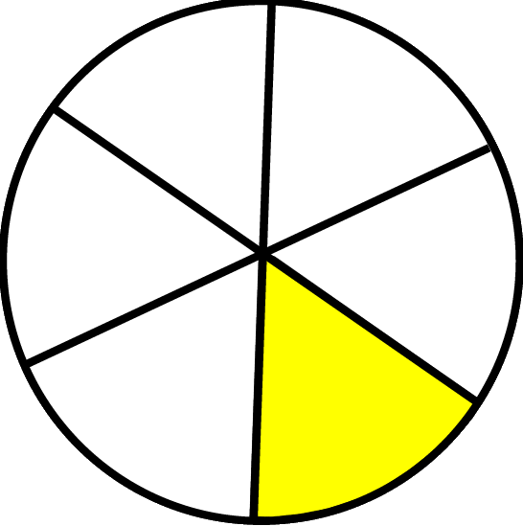
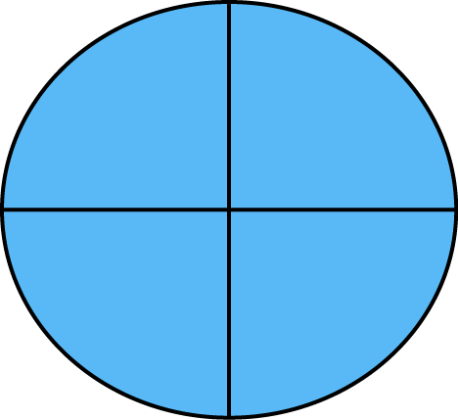
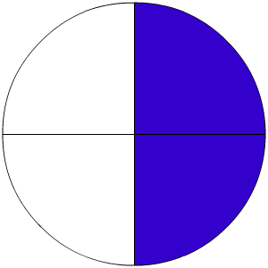
Check your answers!
1.
+ =
2.
+ =
3.
+ =

Slide 8
Wrap up:
Draw a model to represent the following operation and solve it:
Emily uses 3$\frac{1}{2}$ cups of flour and 2 $\frac{1}{2}$ cups of sugar to make a cake. How much flour and sugar does she use in total? Show your answer using a mixed number and improper fraction

Slide 9
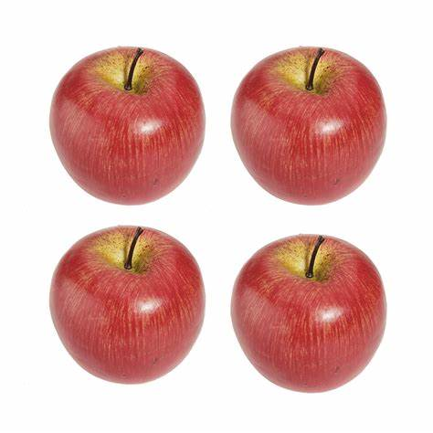
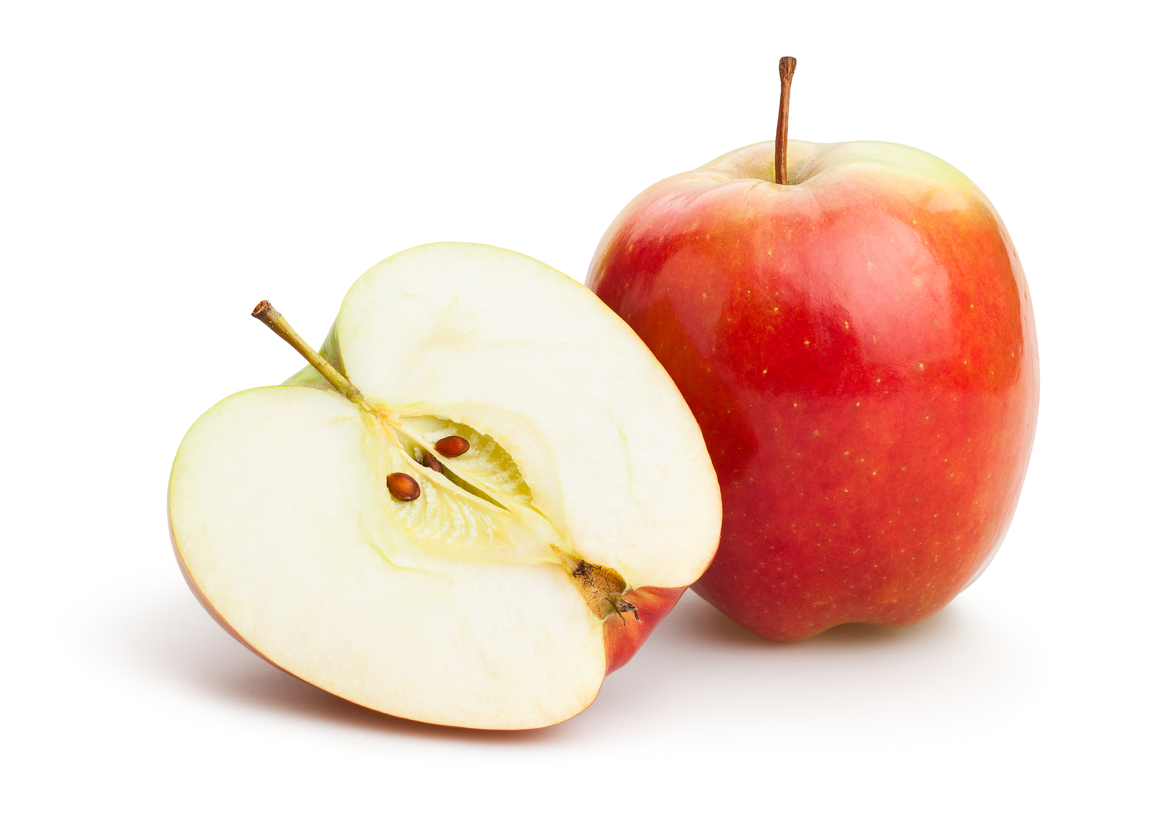
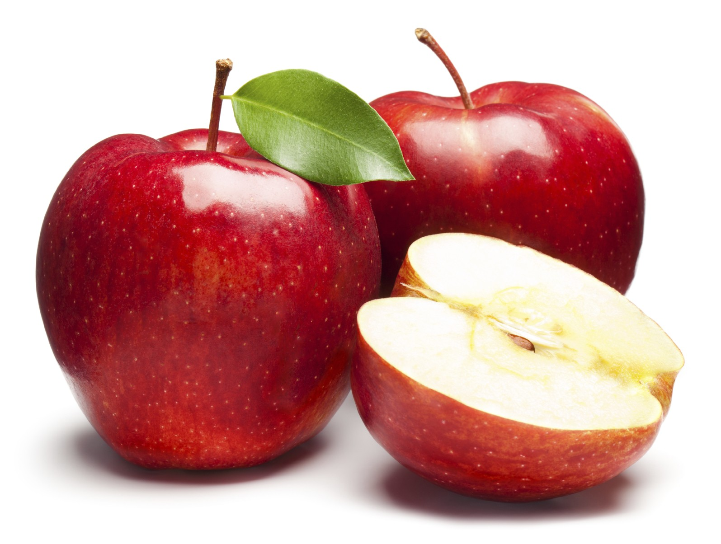
Warming up…
Create a word problem to match the models below:

Slide 10
Changing Improper Fractions into Mixed Number Fractions
$\frac{5}{4}$
Divide the numerator by the denominator. 5 ÷ 4 = 1 R1
The answer is the whole number, and the remainder is the numerator. = 1 $\frac{1}{4}$
The denominator stays the same
$\frac{5}{4}$ = 1 $\frac{1}{4}$

Slide 11
Practice!
Change the following Improper Fractions into Mixed Number Fractions:
$\frac{7}{3}$
$\frac{8}{5}$

Slide 12
Changing Mixed Numbers into Improper Fractions
Multiply the whole number by the denominator. 1 x 4
2. Add the answer to the numerator $\frac{4+2}{4}$
3. The total is the improper fraction $\frac{6}{4}$
1 $\frac{2}{4}$
1 $\frac{2}{4}$ = $\frac{6}{4}$

Slide 13
Practice!
Change the Mixed Numbers into Improper fractions :
1. 3 $\frac{2}{5}$
2. 2 $\frac{1}{3}$

Slide 14
Wrap Up…
Alejandro is making a cake. He uses $\frac{2}{5}$ cups of strawberries and $\frac{4}{5}$ cups of raspberries. How many cups of fruit does he use in total? Show your answer as a mixed number and improper fraction.

