Slide 1
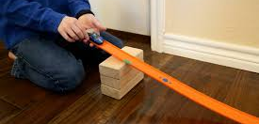
RAMPS: POTENTIAL AND KINETIC ENERGY

Slide 2
In which ramp will the car have more kinetic energy? Why?
Notes:
More potential energy, more kinetic energy
Gravitational (ramp 2) because on the inclination

Slide 3
Hypothesis
The ball in RAMP # 1 , will move ____________ because ____________________________________________________________________.
The ball in RAMP # 2, will move ____________because ____________________________________________________________________.
Notes:
Ramp 1 Further because has more kineti energy
Ramp 2 not as far because has les kinetic energy.

Slide 4
TYPES OF ENERGY | INDEPENDENT Change | DEPENDENT Observe or measure | CONTROL Keep the same
Notes:
Types of energy: Kinetic-Mechanical/ Potential-Gravitational
Independent:The inclination
Dependent: Distance that the ball moves
Control: Same ramp, same ball

Slide 5
WHICH RAMP HAS THE BIGGEST INCLINATION? WHY? WHAT IS THE BAR GRAPH MISSING? COMPLETED
Notes:
Ramp # 1
Unites of measurement cm Y axis
Categories X axis

Slide 6
Make three drawings to explain the energy transformation that you can see when a marble rolls down a ramp and hits a box. Label the types of energy.
Marble on top of the ramp. | Marble rolling down the ramp. | Marble hitting the box.
Notes:
Potential, Kinetic, Kinetic

Slide 8
The ramp with the bigger inclination will produce a /an
Increase the kinetic energy of the car.
Decrease the kinetic energy of the car.
The ramp with the smaller inclination is going to
Increase the kinetic energy of the car.
Decrease the kinetic energy of the car.
In the ramp with the bigger inclination the car will have
More gravitational potential energy.
More chemical potential energy.
More elastic potential energy.
Notes:
A, B, A

Slide 9
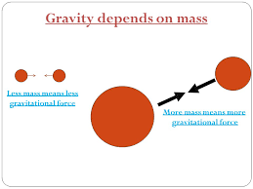
What will happen if you roll down a heavier car?
Notes:
It will go faster because it has more mass and it has more kinetic energy.

Slide 10
Make a drawing of the perfect ramp to decrease kinetic energy.
Notes:
A ramp with a small to none inclination.

